Slide 1
Engineering Knowledge from the Published Medical Literature
Applying Natural Language Processing Methods to a Corpus of Castleman Disease Articles
Stephen Howe
Northeastern University
30 March 2019

Slide 2
"Literature-based Discovery (LBD) seeks to discover new knowledge from existing literature in an automated or semi-automated way. Scientific literature is growing at an exponential rate causing researchers to become increasingly specialized, and making it difficult for researchers to stay current in even their narrow discipline. There is too much information for anyone to read, much less understand" (Henry & McInnes, 2017).

Slide 3
Table of Contents
Executive Summary
Explanation of Deliverables
Project Context
Project Plan
Exploratory Analysis
The Data
Exploratory Analysis
Findings + Recommendations
Review of Hypotheses
Recommendations
Future Research
1-Page Summary
References

Slide 4
Recommended Reading Path
Executive Path
Executive Summary (5)
Explanation of Deliverables
Project Context (13)
Project Plan
Exploratory Analysis
The Data
Exploratory Analysis
Findings + Recommendations (69)
Review of Hypotheses (70)
Recommendations (74)
Future Research (78)
1-Page Summary (80)
References
Analyst Path
Executive Summary
Explanation of Deliverables
Project Context (13)
Project Plan
Exploratory Analysis (34)
The Data (35)
Exploratory Analysis (40)
Findings + Recommendations (69)
Review of Hypotheses (70)
Recommendations (74)
Future Research (80)
1-Page Summary
References
Notes:
If you are pressed for time, I recommended focusing on the key areas highlighted in red depending on your level of interest.

Slide 5
Executive Summary
Notes:
This section presents an overview of the problem statement, the overall conclusions, specific actionable opportunities, and recommendations for future analysis.

Slide 6
Summary of Project and Findings
The driving question behind this research is:
How can I, as a researcher, quickly identify the information pertinent to my areas of study in order to advance my understanding and knowledge to better direct my research?
After my analysis, I conclude:
Literature-based discovery is an efficient and effective method for extracting information and insights from large sets of data that benefit the scientific researcher and presents a growth opportunity for the scientific publishing industry.

Slide 7
Summary of Work
This analysis used metadata describing 2417 articles on Castleman Disease from the National Library of Medicine
This analysis applied various statistical and natural language processing techniques to this set of data:
Descriptive analytics
Document summarization
Network graphs for citations and affiliations
Topic modeling
Document clustering

Slide 8
Actionable Opportunity
For researchers interested in a specific topic, the set of methods demonstrated in this POC can be used to answer questions such as:
When did the research on this topic happen?
Who is publishing in this area?
What are the main topics covered in the literature?
What are the seminal articles that I should read?
What are those articles about?
Who is publishing with whom?
Who is funding the research in this topic?

Slide 9
Future Analysis Opportunities
This project leaves many questions unanswered, creating opportunities for additional research.
How can these methods be scaled beyond a small set of articles (i.e. the full, 29 million article set from MEDLINE)?
Can we train a model to predict the MeSH heading for an unlabeled article?
How can we better resolve entities such as authors and institutions?
Which topics are receiving the most funding?
Will this analysis work in other disciplines?

Slide 10
Explanation of Deliverables
Notes:
This presentation is accompanied by two other artifacts, an RNotebook and an R script. This section describes what each of these deliverables provides.

Slide 11
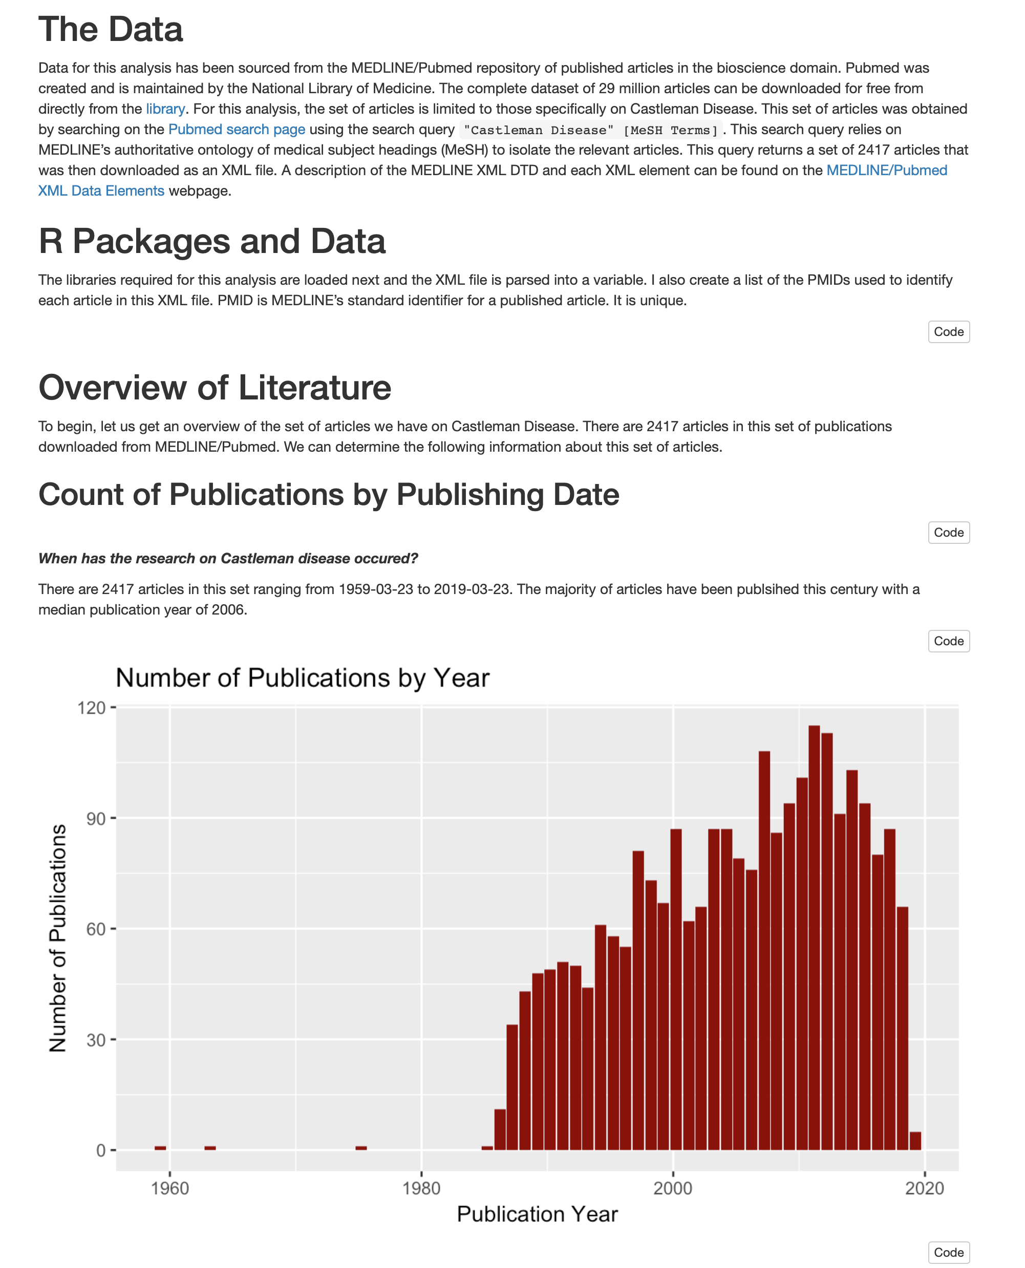
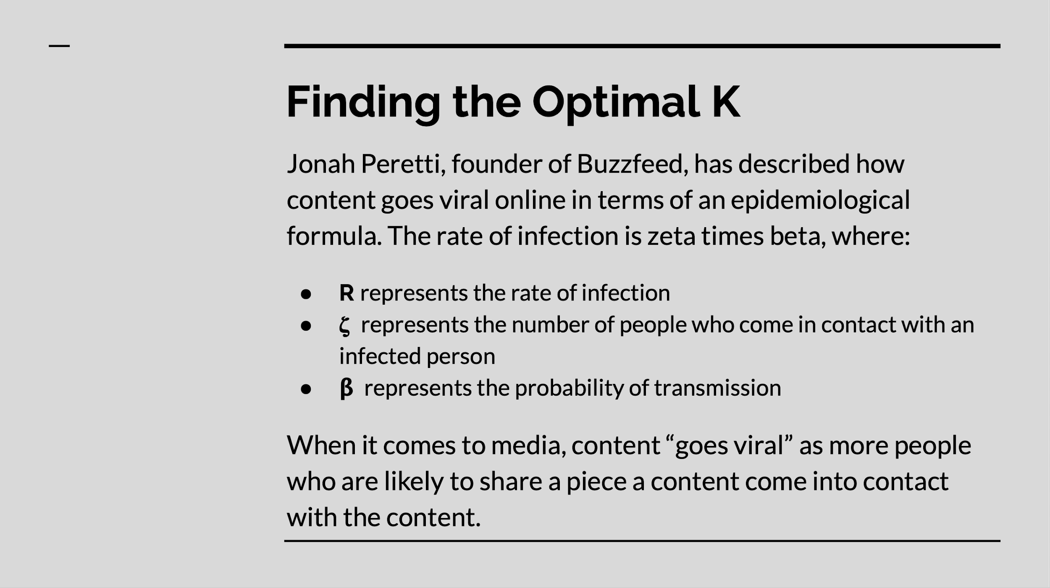
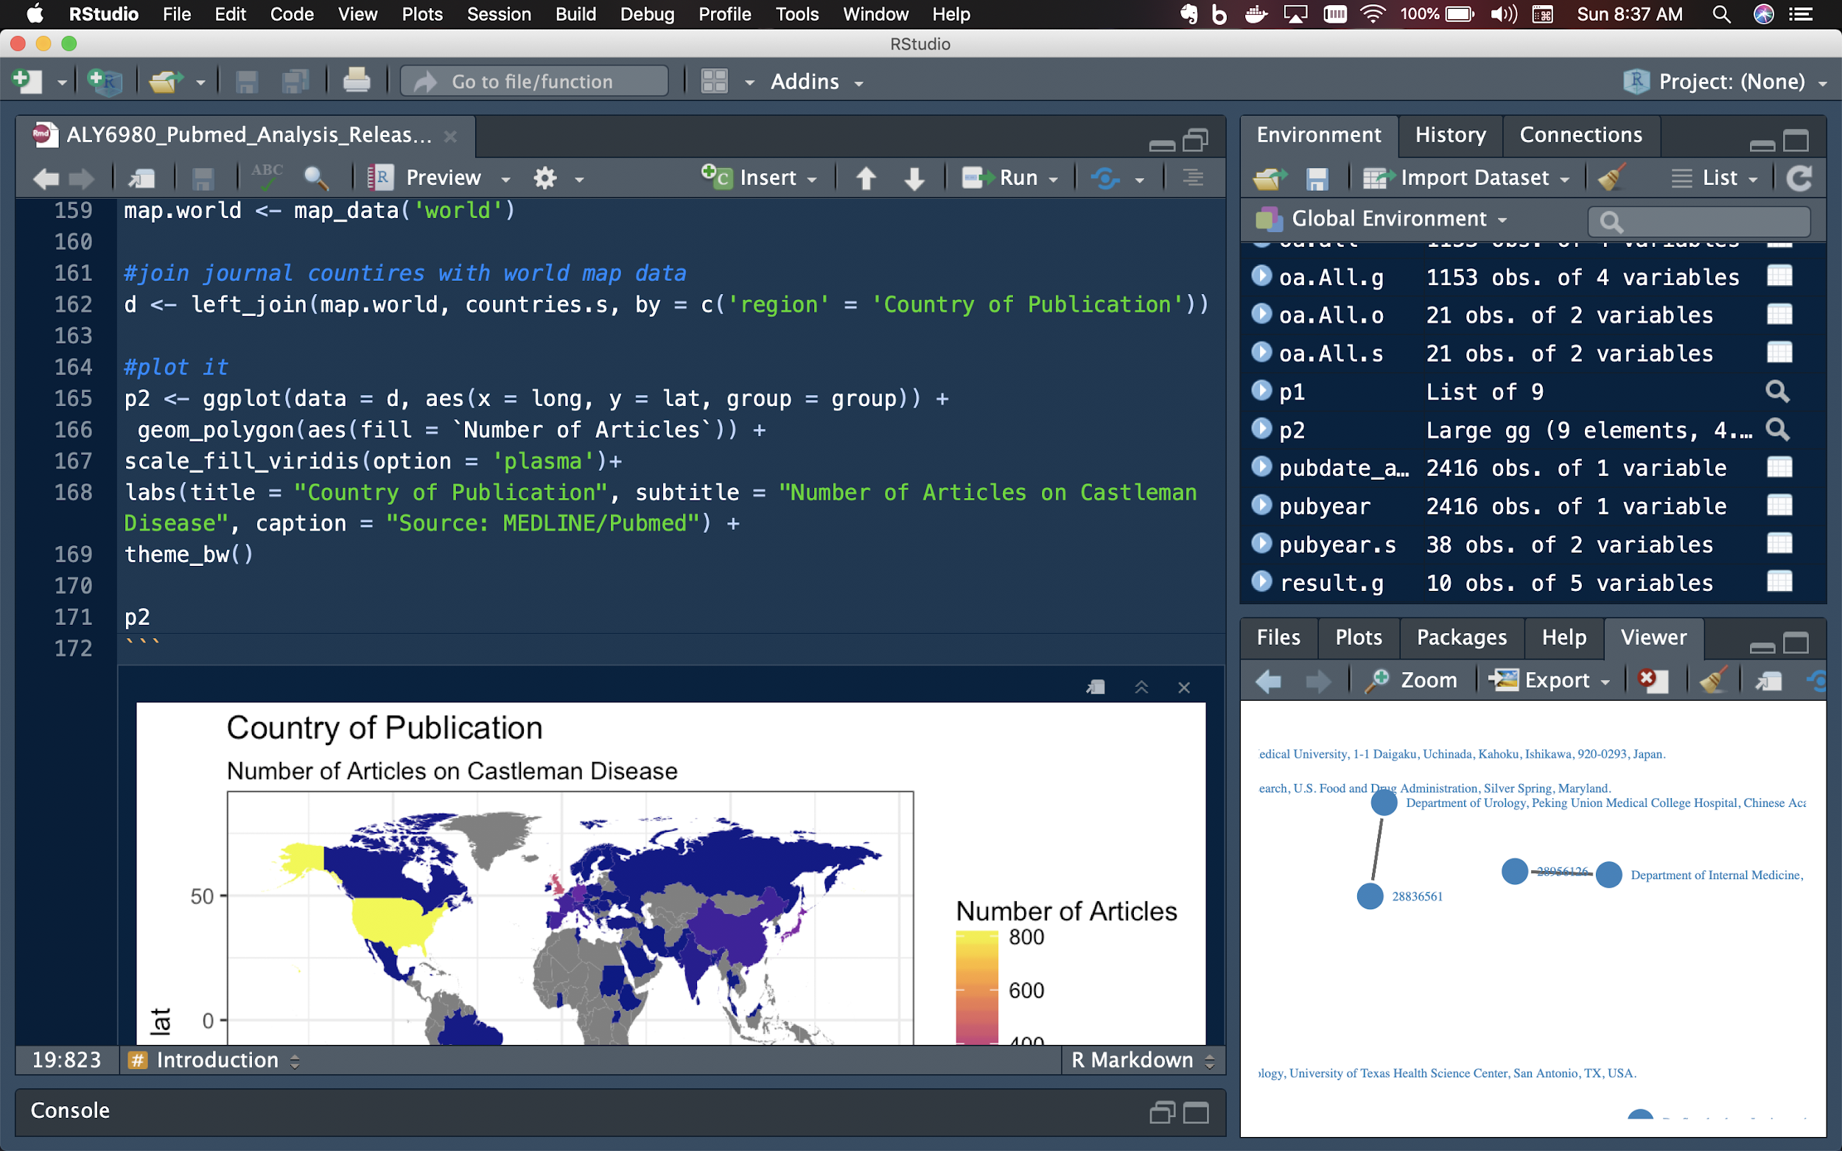
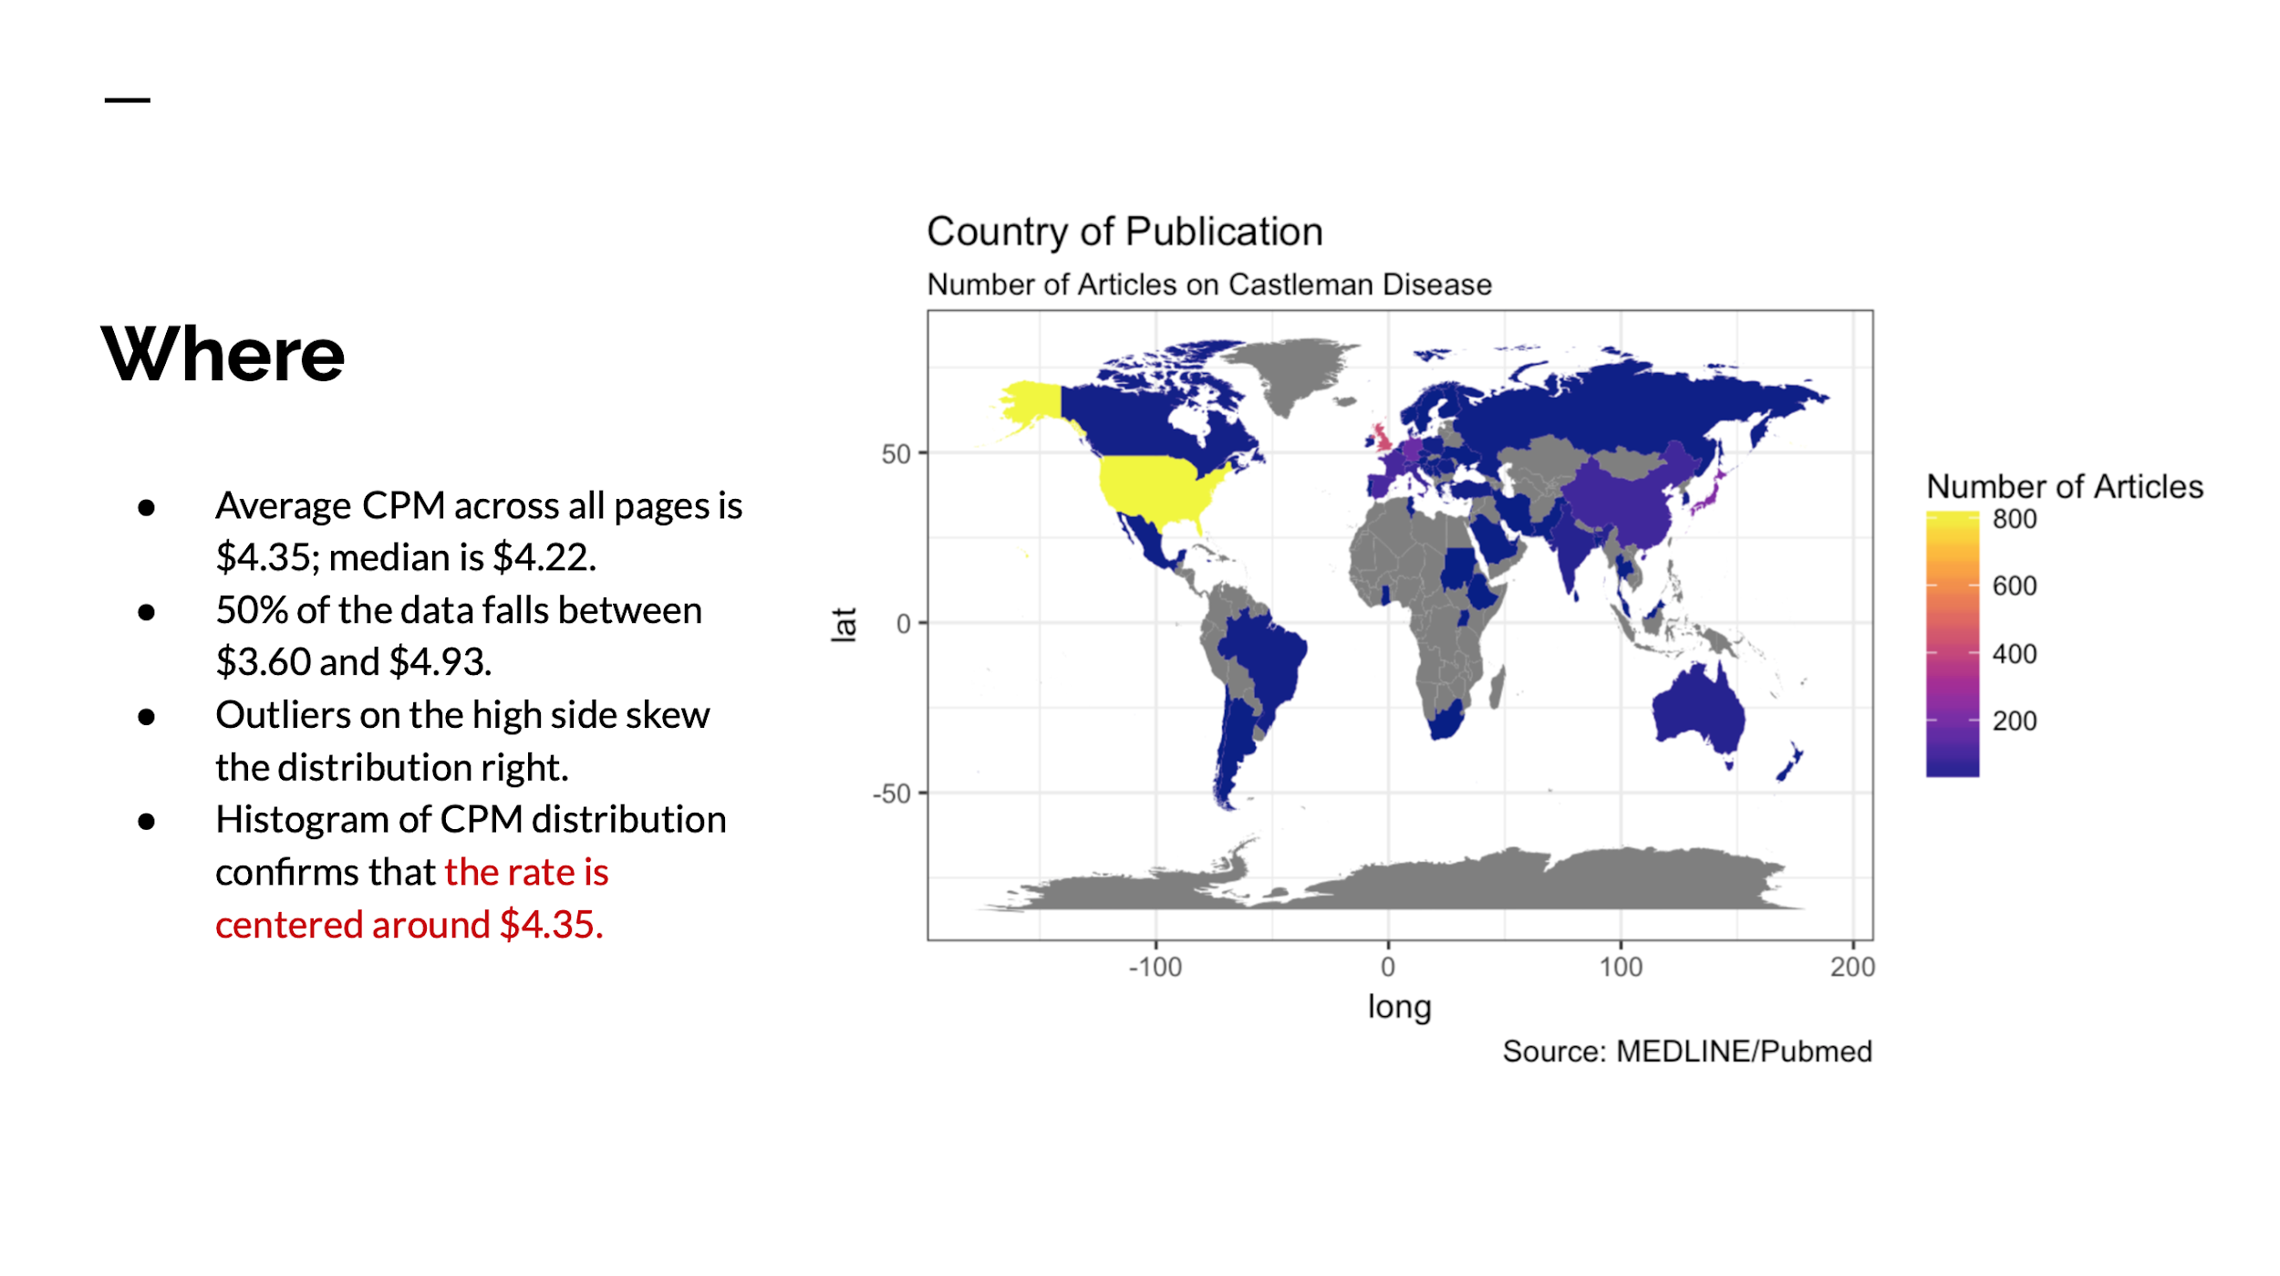
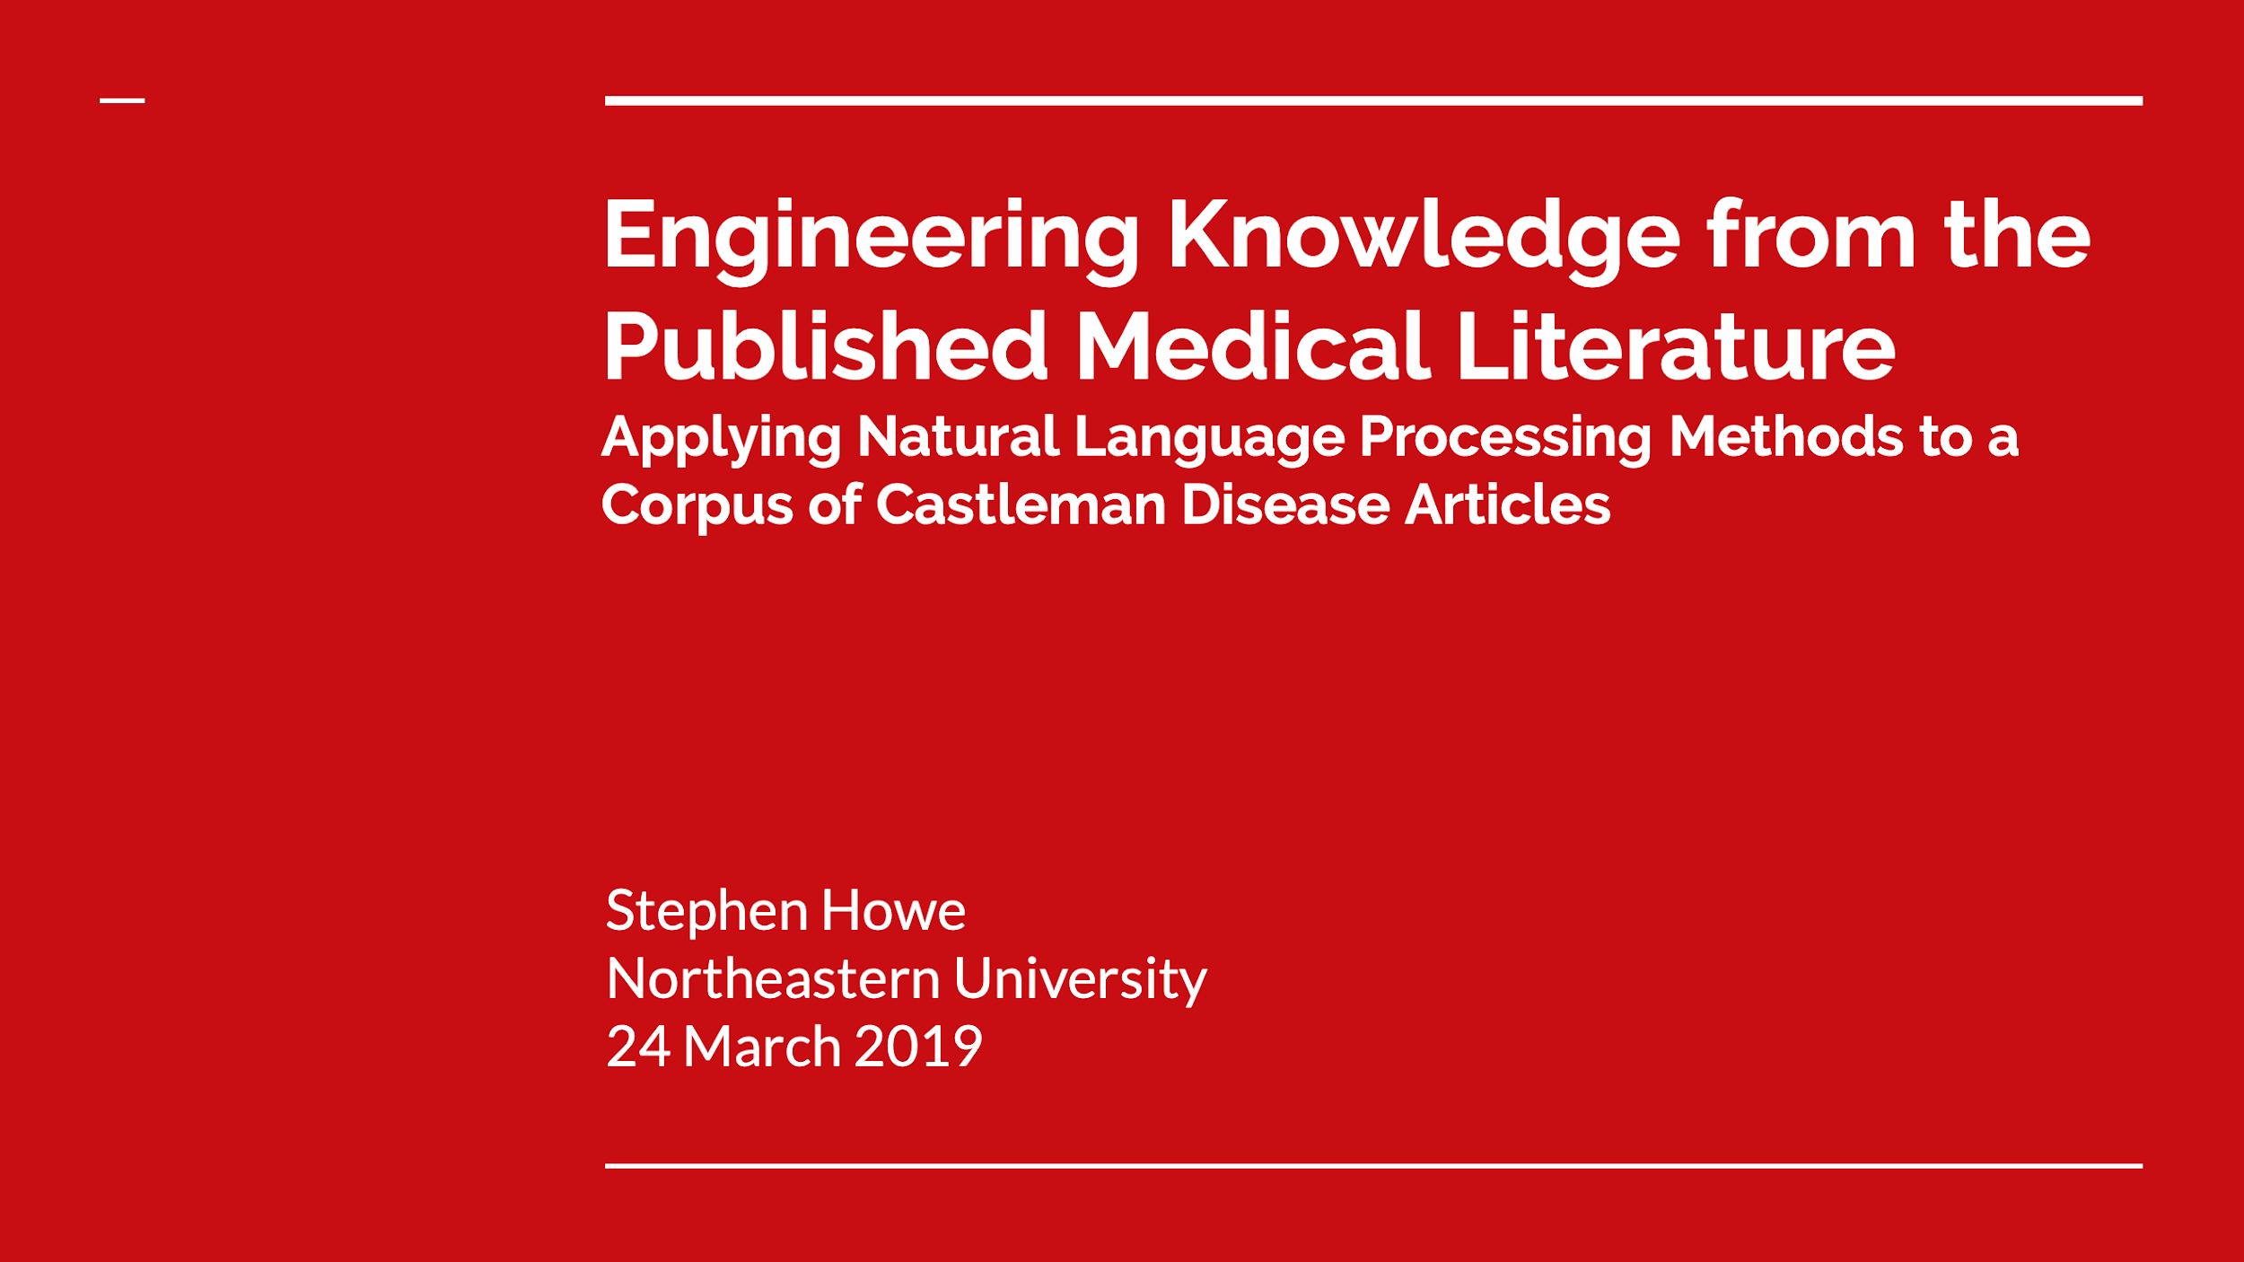
Project Deliverables
The complete analysis and conclusions for this project are available across three documents: a presentation, an R Notebook, and an R script.
Presentation
RNotebook
R Script
Notes:
In the presentation (PPT) you will find an executive summary of the project and my findings, an overview of the project, a description of the problem that we are trying to solve, the project plan, an exposition of the data analysis, my findings and recommendations, as well as a statement of future research opportunities.
The R Notebook is an output of my analysis done in the R programming language and blends descriptive narrative text, R code, and the output for all lines of code. This notebook provides the reader a reproducible artifact of my analysis. The RNotebook is saved as an HTML document which can be downloaded and opened in a standard web browser such as Chrome or Firefox.
The R script is the a copy of the code I wrote to do the analysis.

Slide 12

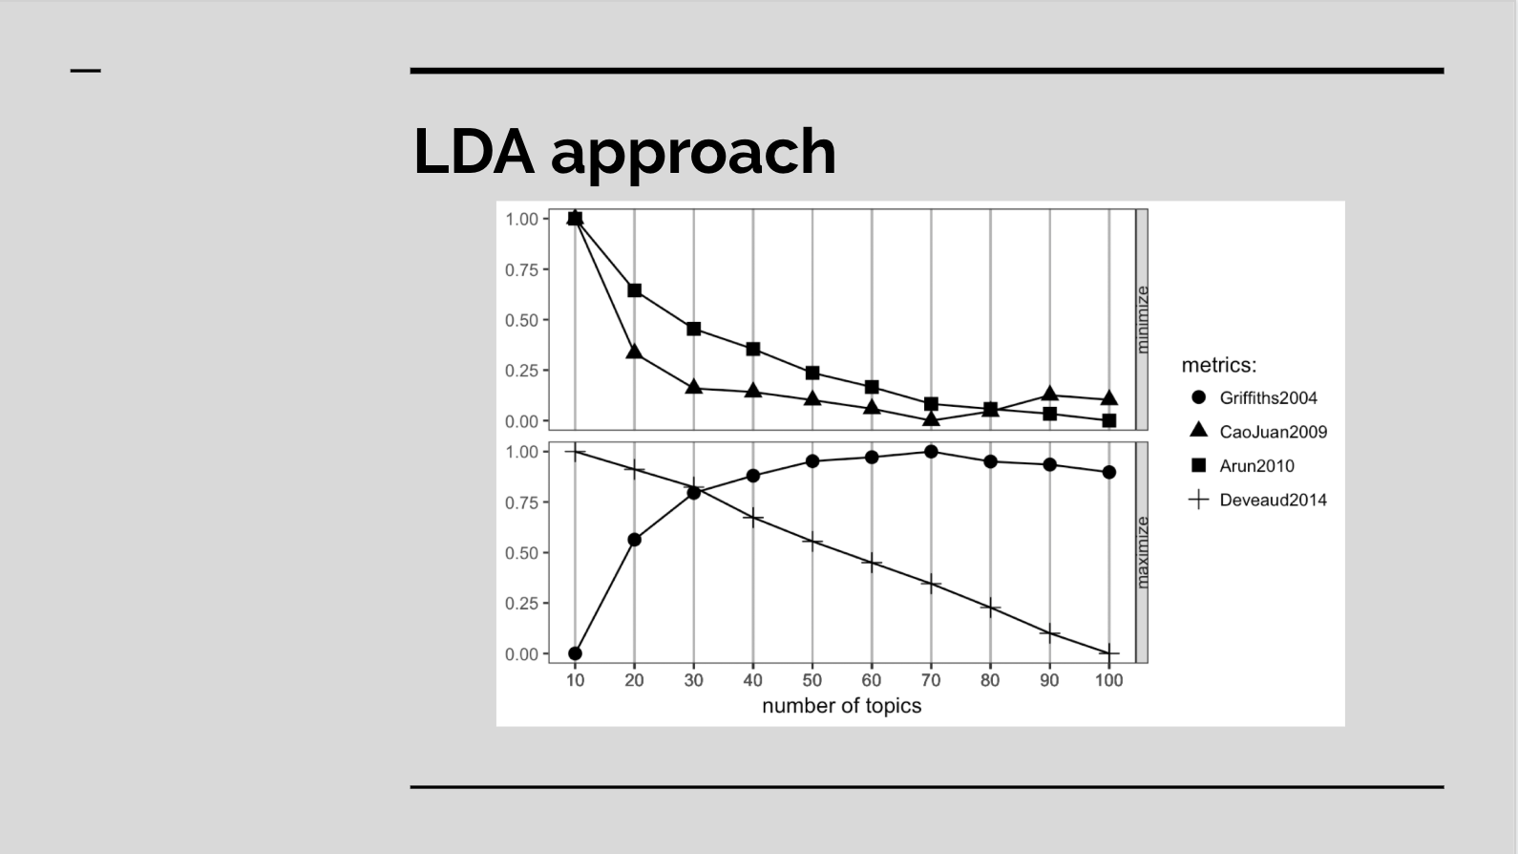

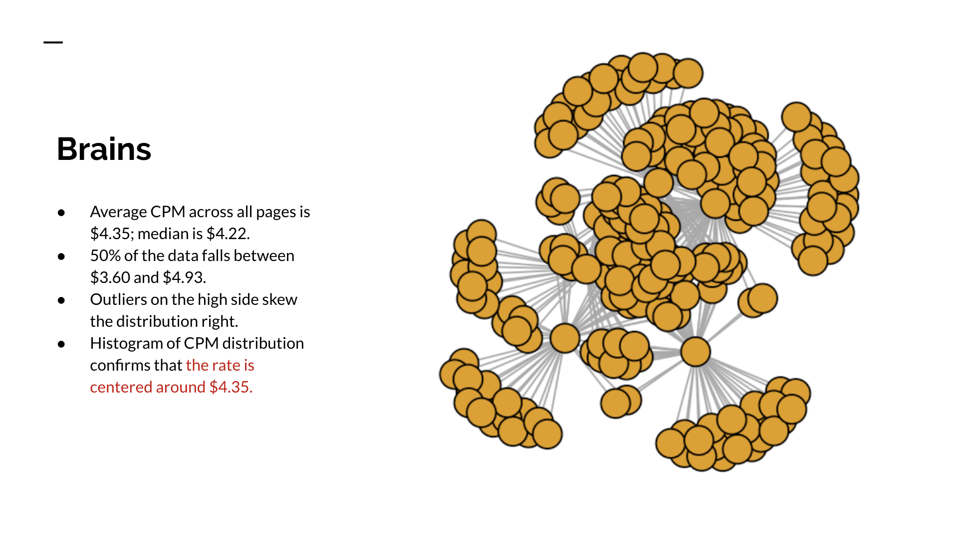
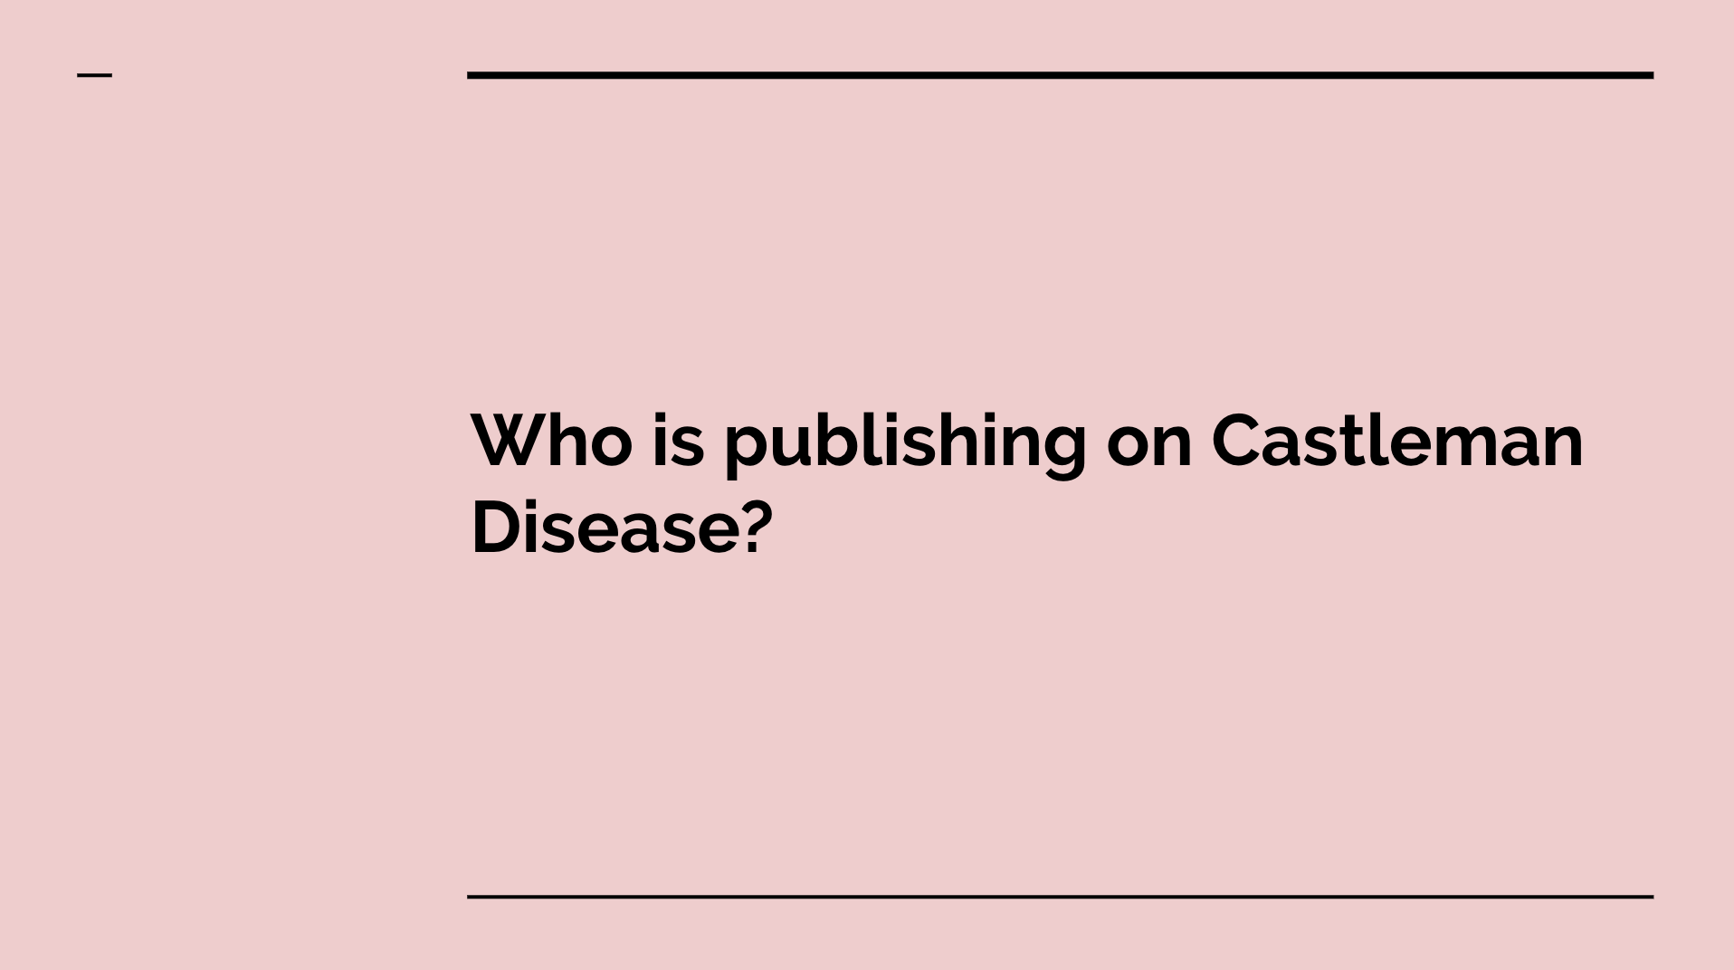
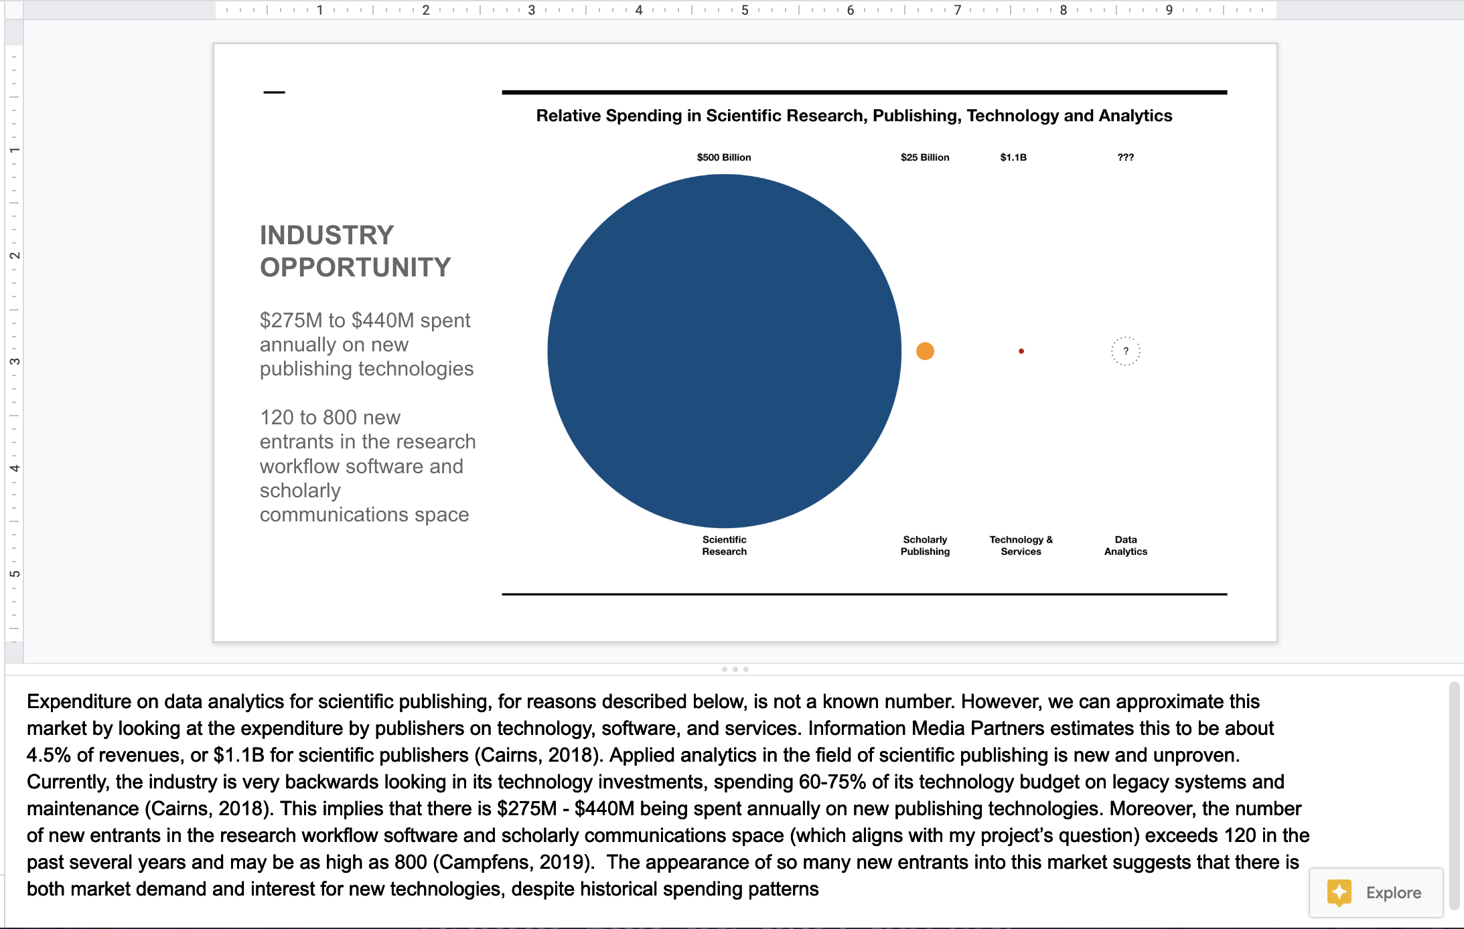
How to Read This Presentation
Red divider pages indicate the start of a new section. These correspond to the table of contents.
Light grey pages indicate content and technical deep dives providing more thorough exploration of a topic.
This presentation uses common design elements to help structure the content and to guide the reader through the narrative. The Table of Contents provides a list of all major sections and subsections. The reader is encouraged to jump right to the section of interest for them.
Grey divider pages indicate the start of a new sub-section. These correspond to the table of contents as well.
White pages indicate the main content of the document.
In the exploratory analysis section, pink dividers indicate the start of a group of related analytics questions.
Most pages include explanatory notes and details. These can be found in the speaker’s notes section.

Slide 13
Project Context
Notes:
This section provides:
The industry context for the research problem
The industry opportunity that this research could help to support
The current industry challenges that prevent ready adoption of new technologies and analytical approaches
A description of the problem space
Definition of the problem statements
Proposed hypotheses for these problem statements
A synthesis and description of the goals and objectives for this project

Slide 14
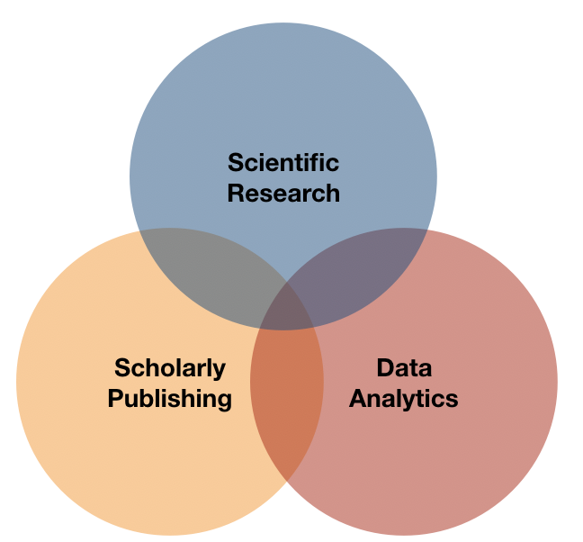
Area of Interest
The area of interest for this project sits at the nexus of scholarly publishing, scientific research, and data analytics.
Figure 1
Notes:
The area of interest for my Capstone project sits at the nexus of scientific research, scholarly publishing, and data analytics (Figure 1). While this description helps us to locate the industry context for my project’s problem space, it is too general to accurately measure the addressable market and to meaningfully identify the key competitors and players.

Slide 15
Industry Context
The United States spends $500B on scientific R&D each year
The world creates over 2 million research-based scientific publications each year
China, United States, Germany, India, and Japan lead
Major repositories of scientific publications boast holdings of 100 million articles
The scientific publishing business generates $25B annually
Elsevier, Taylor & Francis, SpringerNature, and John Wiley & Sons are key players
Notes:
We can use this described nexus as a starting point to define the market opportunity. As a nation, the United States spends half-a-trillion dollars a year on scientific research and development (National Center for Science and Engineering Statistics, 2017). The world creates over 2 million scientific articles a year (led by China, the United States, Germany, India, and Japan); major repositories of scientific publications boast holdings of over 100M articles (Tollefson, 2018). The scientific publishing business generates nearly $25B (£19B) annually, with publishers such as Elsevier, Taylor & Francis, Springer Nature, and John WIley & Sons near the top (Buranyi, 2017).

Slide 16
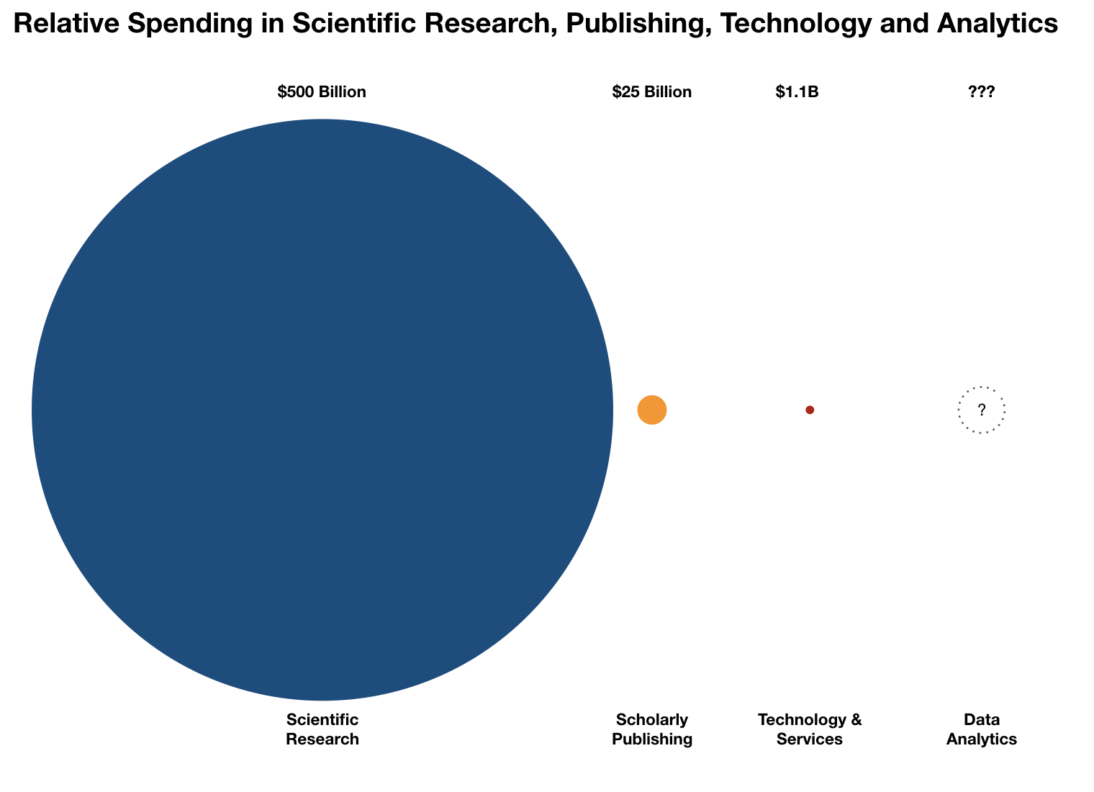
INDUSTRY OPPORTUNITY
$275M to $440M spent annually on new publishing technologies
120 to 800 new entrants in the research workflow software and scholarly communications space
Notes:
Expenditure on data analytics for scientific publishing, for reasons described below, is not a known number. However, we can approximate this market by looking at the expenditure by publishers on technology, software, and services. Information Media Partners estimates this to be about 4.5% of revenues, or $1.1B for scientific publishers (Cairns, 2018). Applied analytics in the field of scientific publishing is new and unproven. Currently, the industry is very backwards looking in its technology investments, spending 60-75% of its technology budget on legacy systems and maintenance (Cairns, 2018). This implies that there is $275M - $440M being spent annually on new publishing technologies. Moreover, the number of new entrants in the research workflow software and scholarly communications space (which aligns with my project’s question) exceeds 120 in the past several years and may be as high as 800 (Campfens, 2019). The appearance of so many new entrants into this market suggests that there is both market demand and interest for new technologies, despite historical spending patterns

Slide 17
Industry Challenges
Technology landscape is fragmented; many incompatible one-off technology solutions
Scientific publishers have willfully underinvested in technology
Historic neglect means technology investment goes to maintenance instead of innovation
Data and technology is forcing change on the industry; companies don’t use data and technology to gain competitive advantage
Notes:
Any participant in, or new entrant to, scientific publishing trying to develop analytical solutions faces a number of entrenched challenges (Cairns, 2018):
The technology landscape is highly fragmented. This is, in part, driven by the industry needing market-specific software solutions and a desire for quick, one-off, modular solutions that they can mix-and-match.
Publishers have historically been extremely cost-conscious in their technology investments leading to a willful underinvestment in technology and neglect of long-term, planful investments.
This historical underinvestment has forced companies to spend the majority of their technology expenditure on the maintenance of legacy systems, rather than new technologies.
Finally, publishers have long been slow to adopt new technologies, and now struggle with newer efforts to engage in digital transformation. As Cairns (2018) succinctly writes: “the level of current technology spending may already be inefficient and ineffective which makes the starting point for improvement weak.”

Slide 18
Problem Space
For the researcher trying to use the output of scientific publishing:
Literature search and review plays a key role in establishing directions for new research (e.g. in pharmaceutical research)
Literature review assists in the interpretation of study results
Literature review is an important, but not the core focus of a scientific researcher
Researchers report that they are drowning in information
The key question: how can I, as a researcher, quickly identify the information pertinent to my areas of study in order to advance my understanding and knowledge?
Two potential winners: researchers and the organizations that serve them.
Notes:
There are two audiences for this research. The primary audience is the researcher who is interested in extracting more information, knowledge, and value from the body of published scientific literature. The secondary audience is the organizations that serve these researchers and who could build a business around this researcher and the data of interest. Stated more pointedly: the clear winner--if there ever is one--will be the organization that can skillfully acquire the broadest set of data and make the right, forward-thinking technology investments to actually extract value from it.
Sources:
Henry & McInnes, 2017
Pistoia Alliance, 2018

Slide 19
Problem Statement 1
In the context of scientific researchers, people are drowning in information
Text-mining of medical literature is inconsistent and creates points of contention in research review
Pharmaceuticals need to do it, but it is not where they gain competitive advantage
Time spent on text-mining literature is time not spent on more valuable, core research
Opportunity: by creating a shared and standard approach for extracting insights from the medical literature, pharmaceutical researchers can remove a resource and time burden and focus on the areas where they can build competitive advantage.
Notes:
The general problem is that researchers are drowning in information resulting in missed opportunities to identify new areas for study and research. Researchers report that the results from text-mining of the medical literature are often inconsistent and create points of contention in research review. Moreover, text-mining of the medical literature is something that all the pharmaceuticals are doing but it is not how they gain their competitive advantage (Pistoia Alliance, 2018). It has been suggested that having a standard approach to text mining is an opportunity shared by all pharmaceutical researchers.
The specific problem is that there is no shared approach or methodology for mining the medical literature, resulting in delays and disagreements within pharmaceutical research. The impact of not having an agreed upon approach to mine the existing medical literature is that pharmaceutical researchers spend time doing literature review and resolving inconsistent results at the expense of doing their actual scientific research. Additionally, without an agreed upon approach and understanding on how to extract knowledge from the scientific corpus, researchers are missing the opportunity to apply these text-mining capabilities during other phases of research like the interpretation of results (Pistoia Alliance, 2018). By creating a shared and standard approach for extracting insights from the medical literature, pharmaceutical researchers can remove a resource and time burden and focus on the areas where they can build competitive advantage.

Slide 20
Problem Statement 2
The rise of Open Access, a new publishing model, represents a challenge and disruption to traditional publishers
Publishers do not understand the current state of the OA market clearly enough to make sound business decisions
There is no comprehensive view of the OA market resulting in indecision, indecisiveness, and lack of a path forward
Opportunity: by creating and providing objective descriptions of the current state of the OA market landscape, we can provide consistency and clarity to the understanding of the market from which scientific publishers can ground their go-forward decision making.
Notes:
The $25B scientific publishing industry is experiencing the rise and disruption of a new publishing model, Open Access (OA). “Open access is a publishing and distribution model that makes scholarly research literature—much of which is funded by taxpayers around the world—freely available to the public online, without restrictions” (Open Society Foundations, 2018). OA is a development that challenges the traditional subscription-based business models of publishers with one where research funders pay for the publication of scholarly research instead of traditional journal publishers. The general problem is that scientific publishers do not understand the current state of the OA market which results in an inability to make sound and grounded strategic decisions about what to do and how to publish. This lack of understanding is driven by the fact that (Piowar, 2018):
The available data on OA licenses is sparse
The interpretation of OA licenses is inconsistent and not standardized
The meaning of specific OA terms is dependent on user context (i.e. corporate researcher, academic researcher, publisher, funder)
Publishers are particularly interested in gaining a better understanding of the overall OA market and their role in it.
The specific problem is that there is no comprehensive view of the OA market resulting in inaction, indecisiveness, and a lack of a path forward. For example, Sage Publishing just released a statement calling for delays and a longer transition period for a funder-backed, pro-Open Access mandate, Plan S. (Sage Publishing, 2019). Publishers do not know how much of the scientific literature is currently published under OA licenses. Publishers do not know how their OA publishing profile benchmarks against the rest of the industry. And publishers and funders do not know which authors or research institutions are most active in the OA space. By creating and providing objective descriptions of the current state of the OA market landscape, we can provide consistency and clarity to the understanding of the market from which scientific publishers can ground their go-forward decision making.

Slide 21
Problem Statement 3
Researchers turn to literature searches and literature reviews in order to understand the current state of their field’s knowledge and for establishing the direction for their new research.
Researchers want to review literature and glean insights from sources beyond the publicly published corpus of works, but the corpus of grey literature is not curated and cataloged in the same way as formally published research.
Opportunity: by finding a mechanism by which we can automatically catalog, classify, and curate artifacts from the literature corpus, we can surface important and valuable artifacts of information to researchers interested in understanding emerging trends and new discoveries in their field.
Notes:
As outlined in the first problem statement, medical and pharmaceutical researchers turn to literature searches and literature reviews in order to understand the current state of their field’s knowledge and for establishing the direction for their new research. Researchers rely on established repositories of scientific articles such as the National Library of Medicine’s MEDLINE database in which to conduct their literature reviews. MEDLINE is a curated repository of metadata describing the published scientific literature for medicine and the life sciences (U.S. National Library of Medicine, Medline, 2018). This repository includes not only bibliographic citations and links to (in some cases) the full-text articles, but more importantly, article abstracts and alignment to the authoritative ontology of medical subject headings, MeSH, using a controlled vocabulary (U.S. National Library of Medicine, MeSH, 2018). The general problem is that researchers want to review literature and glean insights from sources beyond the publicly published corpus of works. Not being able to expand their literature search and literature review to the corpus of grey literature limits the early detection of research trends and limits the sources for the discovery of new ideas (Ćirković, 2018). There is a need for both better access to and discovery of grey literature artifacts.
The specific problem is that the grey literature is not cataloged and curated as is the official body of published literature. This results in the poor discovery of potentially useful works; descriptions of entire swaths of information is missing. This lack of discovery and summaries (abstracts) of grey literature removes an “essential resource in scholarly communication, research, policy making and a key source of evidence, argument, innovation, and understanding in many disciplines” (Ćirković, 2018). By finding a mechanism by which we can automatically catalog, classify, and curate artifacts from the grey literature corpus, we can surface important and valuable artifacts of information to researchers interested in understanding emerging trends and new discoveries in their field.

Slide 22
Hypotheses
Text mining of scientific literature for insights and information is more effective and efficient than manually reading the corpus.
A set of related scientific articles has discoverable patterns of topics that can be used to organize the documents into meaningful clusters.
Text mining can be used to extract relevant market trends from a corpus of scientific literature automatically.
The most influential and cited papers can be automatically identified by a computer.
Natural Language Processing (NLP) tools can be used to automatically generate an accurate summary of an article.
The corpus of scientific literature contains retrievable facts that can be discovered automatically.
Notes:
This slide presents a summary of the hypotheses explored in this analysis. What follows below is a more detailed exposition of those hypotheses.
Problem Statement 1 Conclusion
By creating a shared and standard approach for extracting insights from the medical literature, pharmaceutical researchers can remove a resource and time burden and focus on the areas where they can build competitive advantage.
Hypothesis 1
H₀ = Text mining of scientific literature for insights and information is no more effective or efficient than manual reading of the corpus.
H₁ = Text mining of scientific literature for insights and information is more effective and efficient than manual reading of the corpus.
Hypothesis 2
H₀ = A set of related scientific articles does not have discoverable patterns of topics that can be used to organize the documents into meaningful clusters.
H₁ = A set of related scientific articles has discoverable patterns of topics that can be used to organize the documents into meaningful clusters.
Problem Statement 2 Conclusion
By creating and providing objective descriptions of the current state of the OA market landscape, we can provide consistency and clarity to the understanding of the market from which scientific publishers can ground their go-forward decision making.
Hypothesis 1
H₀ = Text mining cannot be used to extract relevant market trends from a corpus of scientific literature automatically.
H₁ = Text mining can be used to extract relevant market trends from a corpus of scientific literature automatically.
Hypothesis 2
H₀ = The most influential and cited papers cannot be automatically identified by a computer.
H₁ = The most influential and cited papers can be automatically identified by a computer.
Problem Statement 3 Conclusion
By finding a mechanism by which we can automatically catalog, classify, and curate artifacts from the grey literature corpus, we can surface important and valuable artifacts of information to researchers interested in understanding emerging trends and new discoveries in their field.
Hypothesis 1
H₀ = NLP tools cannot be used to automatically generate an accurate summary of an article.
H₁ = NLP tools can be used to automatically generate an accurate summary of an article.
Hypothesis 2
H₀ = The corpus of scientific literature contains retrievable facts that cannot be discovered automatically.
H₁ = The corpus of scientific literature contains retrievable facts that can be discovered automatically.

Slide 23
Goal
The goal of this project is to make the process by which researchers and publishers extract information and gain knowledge from a set of scientific literature more efficient and effective than manually surveying and reading that same corpus of works.
I will demonstrate this by applying various NLP techniques to a corpus of research articles on Castleman Disease.
Notes:
The goal of this project is to make the process by which researchers and publishers extract information and gain knowledge from a set of scientific literature more efficient and effective than a manually surveying and reading that same corpus of works. For example, there are just under 3,000 scientific articles categorized as addressing Castleman Disease in the Medline database maintained by the National Library of Medicine. For a researcher interested in identifying the key and most influential articles and authors, overall trends in scientific research on Castleman Disease, and relevant sub-topics and concepts, the prospect of reading, reviewing, and surveying 3,000 articles manually is daunting, time-consuming, and odious.
More broadly, my research project fits into an ongoing line of inquiry known as Literature-Based Discovery. “Literature-based Discovery (LBD) seeks to discover new knowledge from existing literature in an automated or semi-automated way. Scientific literature is growing at an exponential rate causing researchers to become increasingly specialized, and making it difficult for researchers to stay current in even their narrow discipline. There is too much information for anyone to read, much less understand” (Henry & McInnes, 2017).
The analysis done for this project is directed at the scientific researcher looking to gain new insights from a set of scientific literature. In this notebook, I apply various text-analysis, text-mining, and natural language processing techniques to a set of data describing a small set of published scientific articles on Castleman Disease. The goal here is to demonstrate the kinds of information and insights that can be extracted from published works metadata. The objective here is one of efficiency. For a publishing industry that is still built around single-threaded, human-readable documents, and for the scientific researcher aiming to distill learnings from the published body of literature so that they can move on to their own, core research, the benefit of (semi-)automated knowledge discovery is huge.

Slide 24
Objectives
The objective of this project is to develop a proof-of-concept analytical model that automates the process for extracting information and insights from a set of published scientific literature.
Notes:
With an eye to the goal of efficiency and effectiveness, the objective of this project is to develop a proof-of-concept (POC) analytical model that automates the process for extracting information and insights from a set of published scientific literature. This POC will take as its input an XML file exported from the PubMed/MEDLINE database.

Slide 25
Key Questions & Topics
What topics and concepts are discussed in this set of articles?
Which articles are the most influential in this body of research?
Who are the most prolific authors and institutions doing research in the areas covered in the set of articles?
Who is funding the research?
When was the most influential research published?
Can the model automatically summarize the contents of key articles?
Notes:
Outcomes and Deliverables
The outcomes and deliverables for this project, due at the end of the Winter Quarter, include:
A presentation describing the industry context, the problem space, the specific problem statements, hypotheses, data used, analysis techniques, and the final results. A set of articles on Castleman Disease will be used as the core use case.
A functioning, programming notebook (R Notebook) that takes MEDLINE XML as an input and outputs answers to the questions above using text and data visualizations.
The time to run the code and produce answers is measured in minutes and hours, not days and weeks (i.e. a significant reduction in time when compared to a manual, human review of the same set of works).

Slide 26
Project Plan

Slide 27
Overview of Project Plan
The project plan in the following pages covers:
Project Scope
Project Deliverables
Project Boundaries
Project Constraint
User Acceptance Criteria
Project Phases
Notes:
This structure of the project plan follows the guidance as proposed by Makar (2018).

Slide 28
Project Scope
The scope of this project is twofold and includes:
The data analytics work needed to conduct an analysis of a corpus of medical literature in order to develop the proof-of-concept model
The work needed to document and summarize the findings of these proofs-of-concept.

Slide 29
Project Deliverables
The main deliverable for this project will be a report documenting the results of the analytical model proof-of-concept. The report will be in the form of a presentation deck.
A secondary deliverable will be the R scripts and data used to develop the model and a notebook containing the code’s output along with a narrative.

Slide 30
Project Boundaries
This project has the following boundaries:
The project is time-bound to the twelve weeks of this Capstone course
The project resources consist of one analyst
The analysis is limited to the publicly available medical literature provided by PubMed / NIH

Slide 31
Project Constraints
This project has the following constraints:
The analyst has limited knowledge and experience in the domain of medical research creating a risk that the work will take longer and may produce less accurate / relevant interpretations.
The time available for this project may not be sufficient in order to complete the proof-of-concept.

Slide 32
User Acceptance Criteria
We will know that we are done when we can state whether the project hypotheses are proved or disproved. More specifically, the analysis should answer these kinds of questions:
What are the current publishing trends for specific medical topics?
Can we automatically summarize the contents of a given published article?
Can we identify the key concepts found in a body of literature?

Slide 33
Project Phases
This project will run for twelve weeks and will consist of four phases.
Phase 1. Understand the project context, obtain data, conduct exploratory data analysis, and conduct industry research.
Phase 2. Conduct text analysis on medical literature; develop proof-of-concept model.
Phase 3. Document findings and complete report.

Slide 34
Exploratory Analysis
Notes:
A detailed explanation of the data, the steps taken in the analysis, and any working code, can be found in the accompanying RNotebook and .Rmd file. The RNotebook is saved as an HTML file and can be viewed by downloading it and opening it through a web browser such as Chrome or Firefox.

Slide 35
The Data

Slide 36
Data - Overview
Data for this project was sourced from the National Library of Medicine’s PubMed and MEDLINE citation repositories. These repositories hold 29M+ bibliographic citations for published works in the field of science, specifically biomedicine. Data dimensions of interest include:
Abstracts
Author name and affiliation
Funder name
Citation references
The data is provided by the National Library of Medicine, free of charge, in XML format, and is considered an authoritative repository of medical literature and citations.

Slide 37
Data - Castleman Disease
Castleman Disease is a rare disease of the lymph nodes and was first described by Benjamin Castleman in 1956.
In order to focus this research on text-mining applications rather than Big Data infrastructure approaches, I have chosen to focus on a single disease: Castleman Disease.
A subset of the 29M MEDLINE/Pubmed articles was selected by searching for ”Castleman Disease” [MeSH Terms] via the Pubmed interface.
The result is 2417 articles curated by the NLM and aligned to the MeSH heading specific to Castleman Disease.
Notes:
The entire repository holds over 29 million article citations. I do not have the time nor the resources to build out the technological infrastructure needed to process this volume of data. Following the advice of Bradford (2018) to aim for focus and specialization, I am limiting my project to just those articles related to one disease, Castleman Disease. This allows me to work with a much smaller set of data (~2500 articles) and focus on my research questions about how to get insights out of medical text and text citations. This approach leaves doing the same analysis at scale and volume to a future project.
Castleman Disease is a rare disease of the lymph nodes and was first described by Benjamin Castleman in 1956 (American Cancer Society, 2017). Incidentally, after I started this project and had chosen to focus on Castleman Disease, I learned that Benjamin Castleman is the uncle of one of my colleagues at work.

Slide 38
Data - Challenges
Author Disambiguation. Author information is stored inconsistently and as a string. Use of standard identifiers, such as ORCID, is sparse.
Full-Text Articles Limited. The full-text of an article is available for only some articles.
Open Access License Not Present. MEDLINE does not provide Open Access licenses.
Country Names Inconsistent. The country names provided for publishers are inconsistent and do not match up to a standard.
Funder Country Not Provided. The country for grant funders is rarely provided. Whereas there are 58 different countries provided for the publishers in my dataset, only two (USA and UK) are provided for funders.
Notes:
Mitigation for author disambiguation: I have chosen to concatenate author first name, middle initial, and last name as a means to gain specificity and uniqueness in author names. The approach is not flawless but does gain me more granularity.
Mitigation for limited full-text articles: I am using the article abstract text as a proxy for the contents of the article. This field is present much more often.
Mitigation for lack of OA licenses: Use other sources, such as CrossRef, to get OA information. Their information is sparse as well. The lack of comprehensive data may be pointing to a business opportunity as well as a data-research question problem.
Mitigation for inconsistent country names: Manually clean up the country names in order to align country names to the list expected by mapping libraries in R.
Mitigation for missing funder country: Similar to the OA problem, this lack of data may point to a business opportunity (i.e. there is value if someone can provide comprehensive data) as well as a data quality issue.

Slide 39
Data - Clean-up & Manipulation
One reason I selected MEDLINE/Pubmed data is because it is a curated dataset and is a recognized, authoritative source. Since it is curated, the data is generally clean. The data is provided in XML with a published DTD and schema.
The majority of effort working with this data was spent extracting data from XML and working with text stored as strings.

Slide 40
Exploring the Castleman Disease Literature

Slide 41
When, in which journals, and where, is publishing on Castleman Disease occurring?

Slide 42
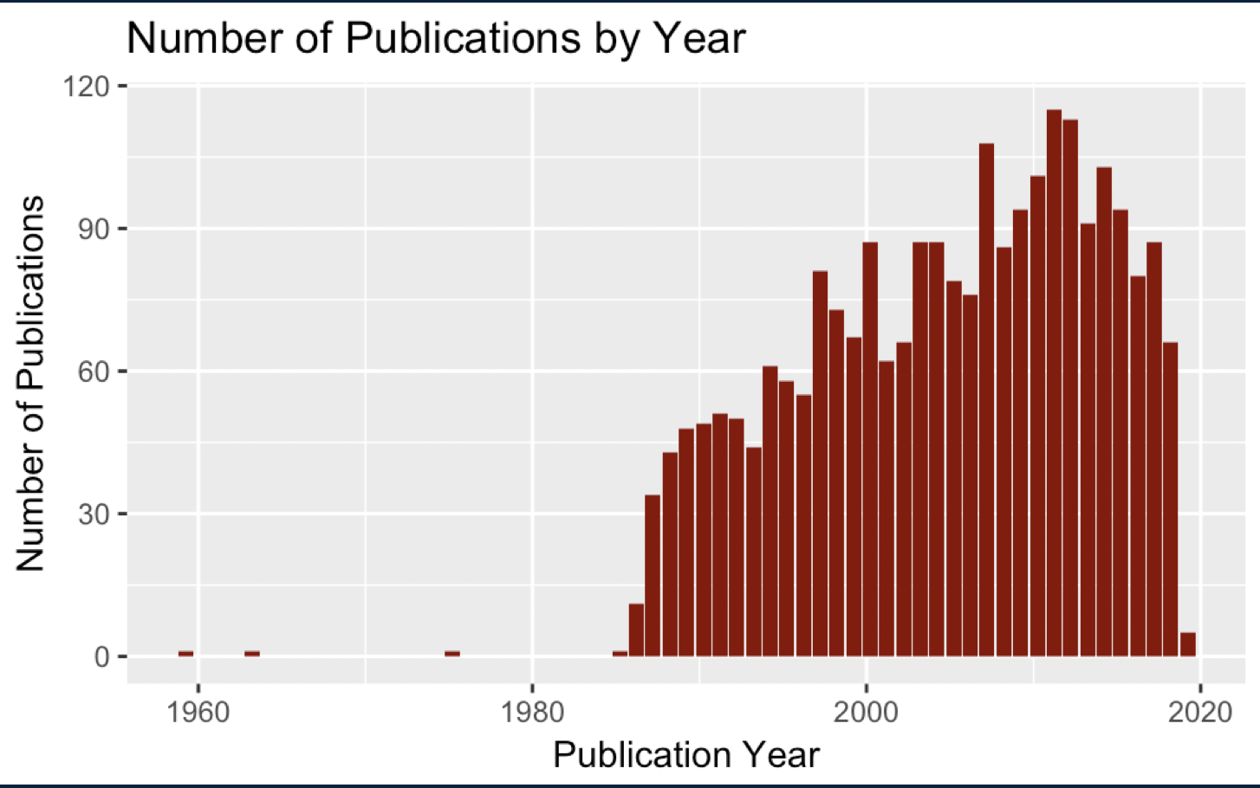
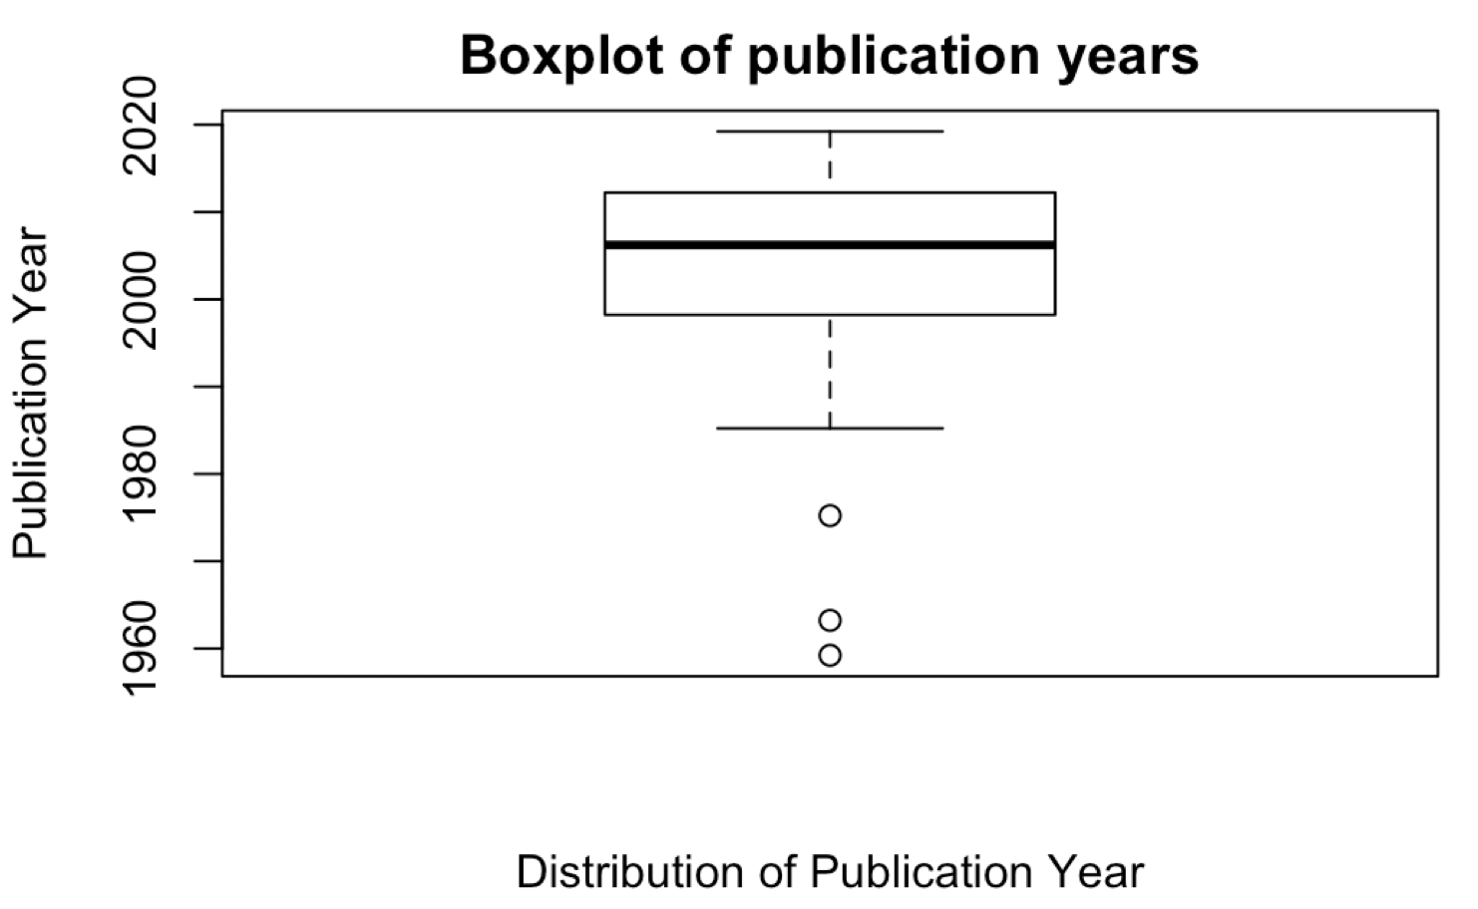
Most research done this century
First described in 1950s
Research began in earnest in the 1980s
Majority of research done this century
Median year of publication is 2006
Overall amount of research is small in volume
Notes:
My search on Pubmed for Castleman resulted in just over 2400 articles. Using a similar approach, searching for the MeSH term “Alzheimer Disease” results in nearly 90,000 articles.

Slide 43
US, UK hematology journals are top
Journal | Number of Articles
Blood | 50
Annals of Hematology | 33
Internal Medicine | 33
American Journal of Hematology | 30
British Journal of Haematology | 26
American Journal of Surgical Pathology | 25
Histopathology | 23
Leukemia & Lymphoma | 18
Rinsho Ketsueki (published by the Japanese Society of Hematology) | 18
Clinical Imaging | 17
Top journals are American and British journals
Top journals focus on hematology

Slide 44
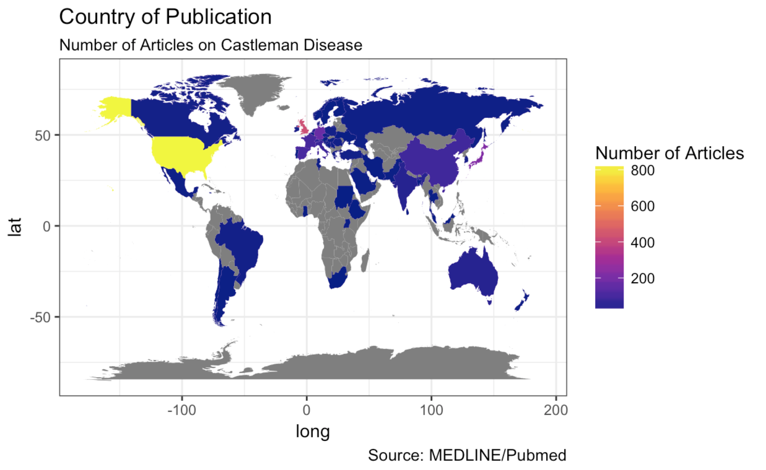
Castleman research has global reach
Castleman research has been published in 58 different countries
US leads with 818 articles (34%)
UK is next with 426 (18%)
Japan published 217 (9%)
Germany had 170 (7%)
Spain had 101 (4%)

Slide 45
Who is publishing on Castleman Disease?

Slide 46
Who are the top authors?
Author | Number of Articles
Masaru M Kojima | 24
Mark M Bower | 20
Corey C Casper | 15
Frits F van Rhee | 15
Norihiro N Nishimoto | 15
Robert R Yarchoan | 15
Angela A Dispenzieri | 14
David C DC Fajgenbaum | 14
Eric E Oksenhendler | 14
Shigeo S Nakamura | 14
The most prolific author has published 1% of the research

Slide 47
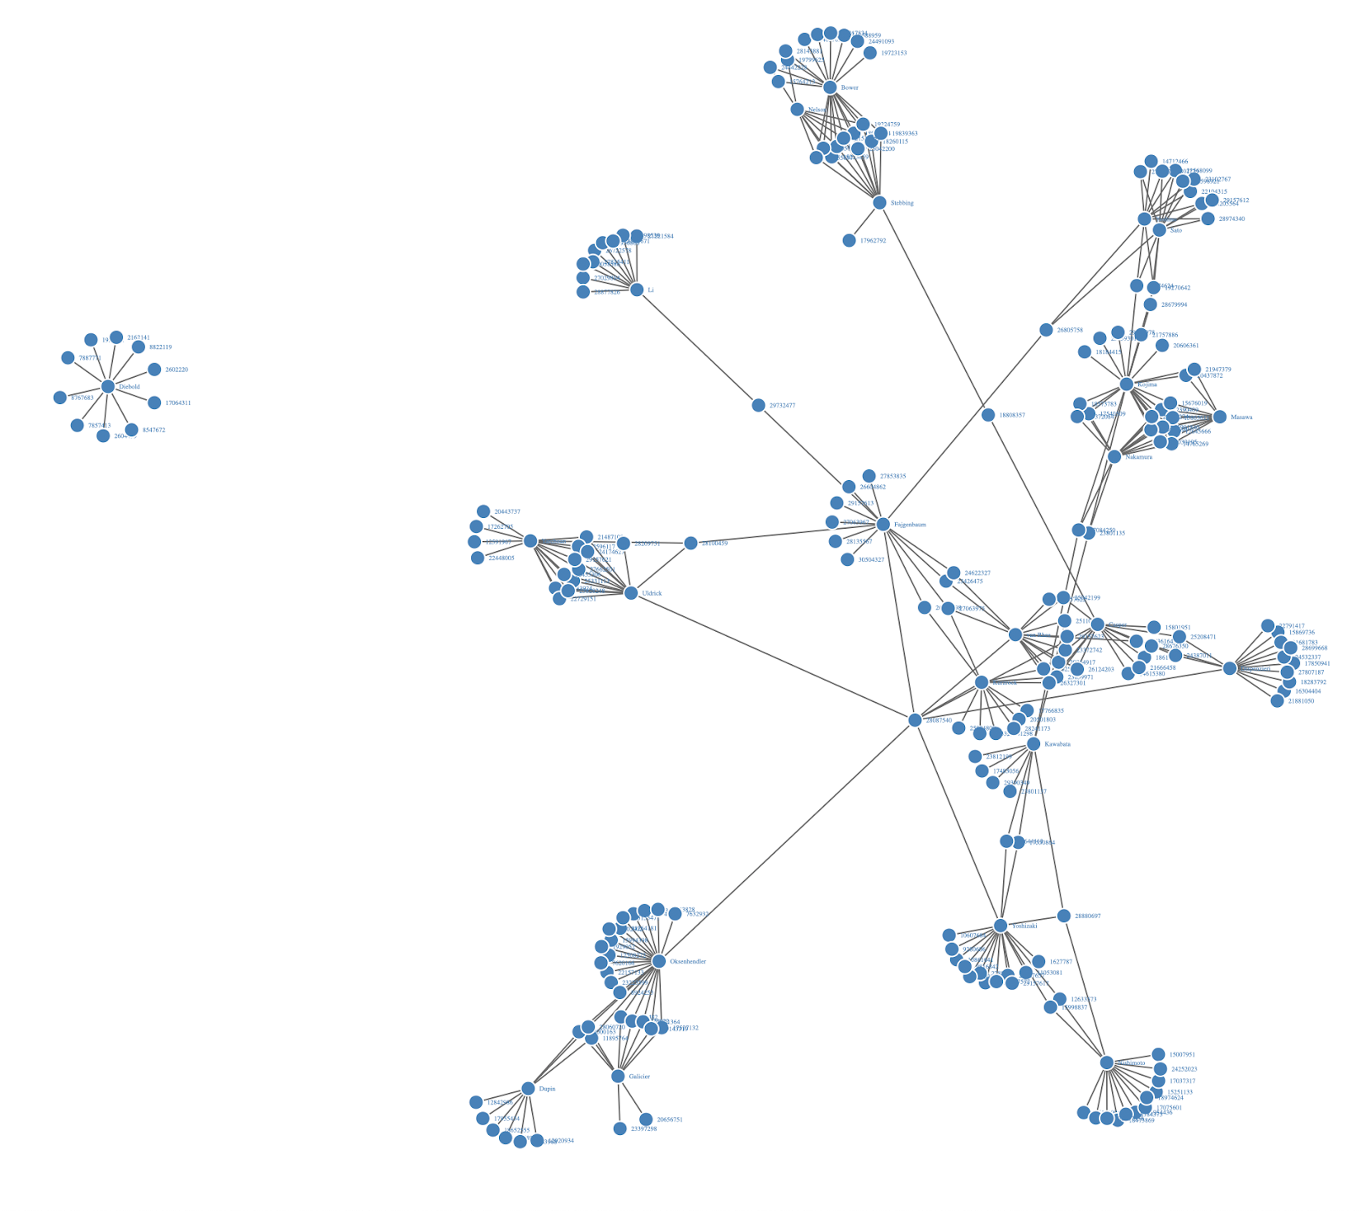
Who published with whom?
A key question to researchers is not just who publishes, but with whom they publish
Using a network graph, we can link authors to their articles and visualize who is working together
We have an isolated (or independent) researcher
Isolated researcher
Notes:
On the right hand side of this slide is shown a network graph of the top 25 authors. This graph shows an author (represented by a name) and the links to the articles they have published (represented by PMID number). Where two or more authors link to the same PMID, they were co-authors. In the upper left-hand corner we see an author that is only linked to PMIDs, meaning they are not publishing with the other top authors.

Slide 48
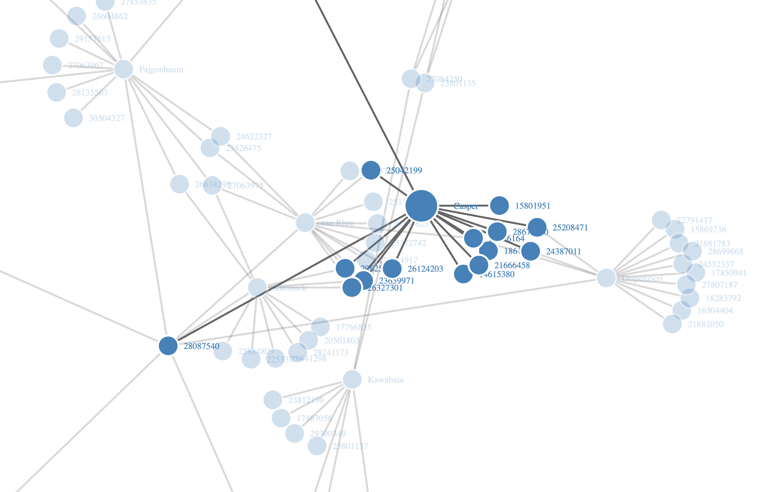
Casper is
connected
Corey Casper
Corey Casper has published on Castleman with:
Dispenzieri
Kurzock
van Rhee
Stebbing
Fajgenbaum
Uldrick
Oksenhendler
Yoshizaki
Articles are represented by PMID number
Notes:
The image on this slide and the previous slide are taken from a interactive network graph showing author connects to the article (shown as the article’s unique identifier, PMID). When executed in the R notebook, the user can focus on nodes, zoom in and out, and pan along the entire graph.
In the graph above, author names are spelled out. Articles are represented by their unique PMID identifier (a number).

Slide 49
Which institutes are active?
Affiliation | # of Articles
Nephrology Center, Toranomon Hospital, 2-2-2, Toranomon, Minato, Tokyo, 105-8470, Japan. | 15
Division of Infectious Diseases and Pulmonary Medicine, Department of Internal Medicine, National Defense Medical College, Saitama, Japan. | 12
UNC Project-Malawi, Lilongwe, Malawi. | 10
Department of Haematology, Peking University First Hospital, Beijing, China. | 10
Henan Key Lab of Experimental Haematology, Henan Institute of Haematology, Henan Cancer Hospital affiliated to Zhengzhou University, Zhengzhou, China. | 10
Department of Cardiology, Keio University School of Medicine, Japan. | 10
David C DC Department of Hematology and Immunology, Kanazawa Medical University. | 9
Haematopathology Unit, Department of Experimental, Diagnostic and Specialty Medicine (DIMES), S. Orsola-Malpighi Hospital, Bologna University School of Medicine, Bologna, Italy. | 9
Hematology Research Center, Ministry of Health of Russia, Moscow, Russia. | 9
‘No affiliation provided’ is the top institute, indicating incomplete and missing data (367 articles)
When affiliation data is present, Asian (Japan, China) institutes rank at the top
Hematology departments are prevalent in the results

Slide 50
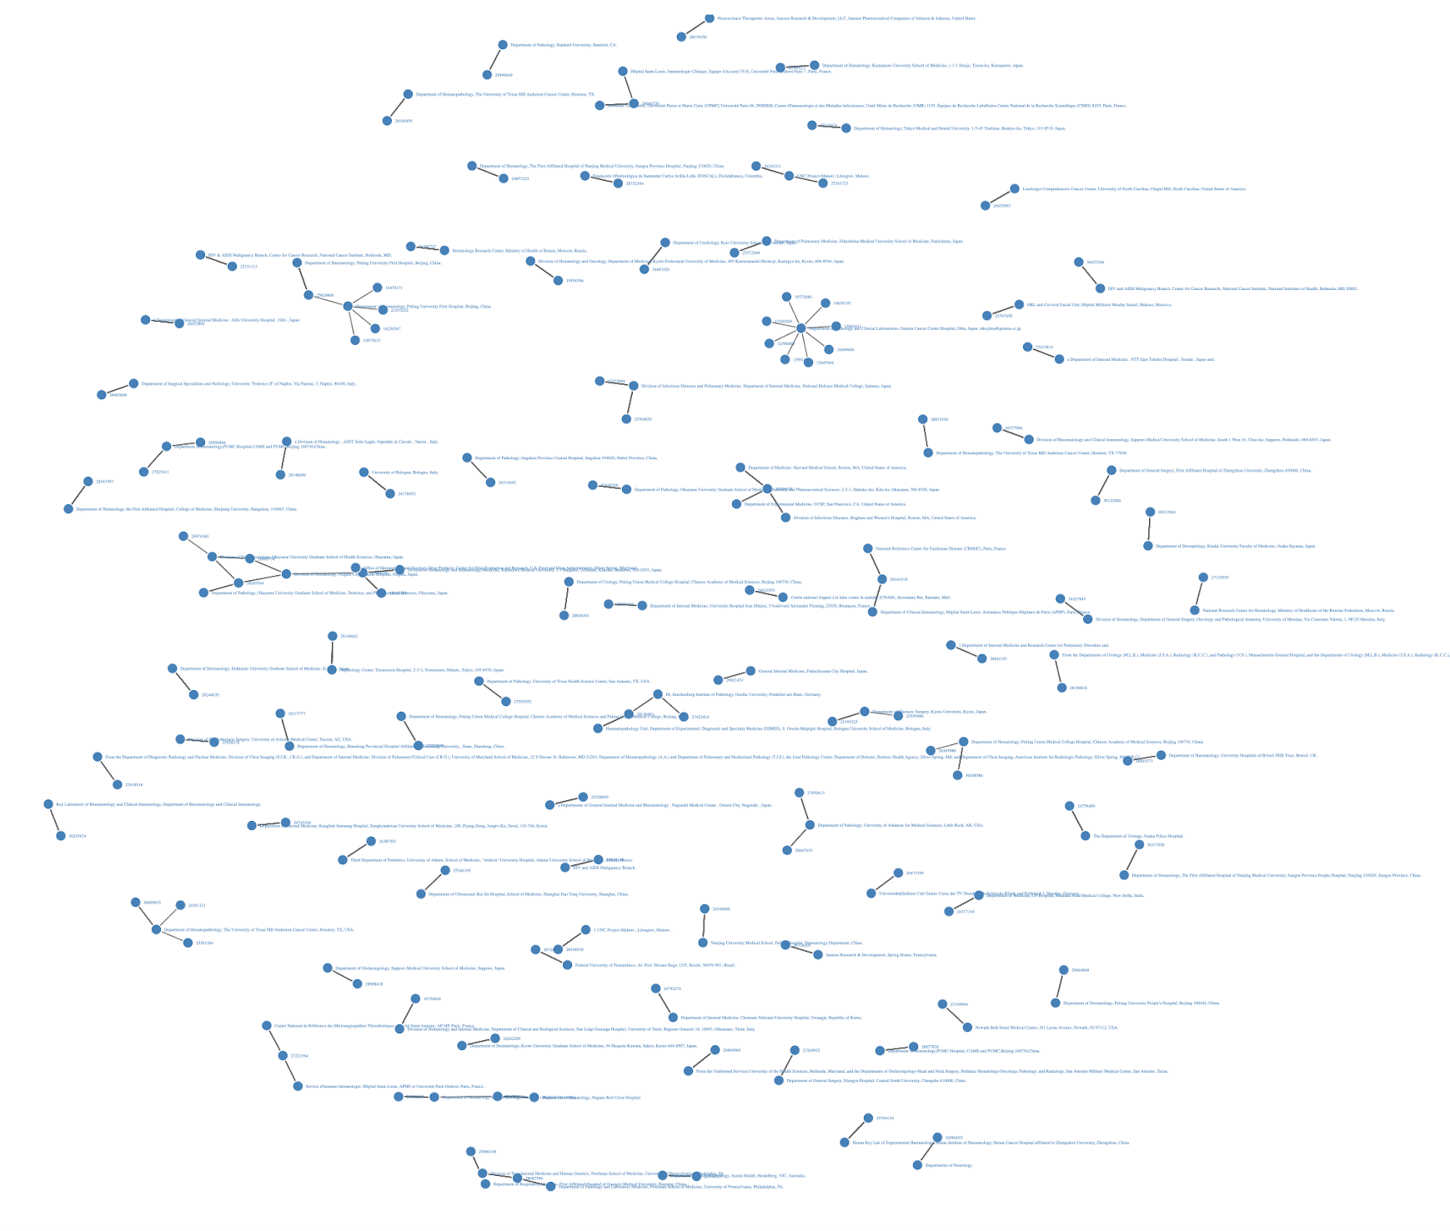
Not Making Connections
Plotting a network graph allows us to see which institutes are working together
Most institutes are not working together
Given the missing affiliation data, this result is not reliable
Notes:
In this network graph, I have connected an institute with the PMID of the article. Two connected dots means 1 institute has published 1 article.

Slide 51
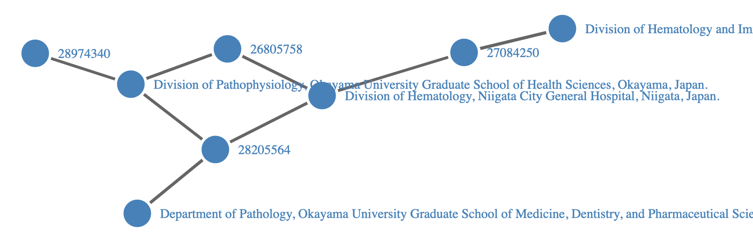
Making Connections
At least one cluster of institutes in Japan have published articles together
Division of Hematology at Niigata City General Hospital has published with three other organizations

Slide 52
What’s in a name?
Entity resolution, or author disambiguation, is a perennial problem in publishing. Entity resolution is the process to reconcile the different manifestations of a single, real-world entity in the data.
Focusing on a single disease in the literature reduces the likelihood for author name confusion
Concatenating forename, initials, and lastname, adds further granularity
Standard identifiers, such as ORCID, are not present enough in the data to be of use
Notes:
Entity resolution, or author disambiguation, is a perennial problem in publishing. Entity resolution is the process to reconcile the different manifestations in the data of a single, real-world entity. For example, authors with common names (Smith, Lee, Wang) can be easily confused with other authors with the same last name. There have been attempts in the research community to establish a standard identifier for researchers. While it has gained some traction, use of the ORCID standard identifier is still sparse compared to the amount of authors referenced in the published literature. For the corpus of 2417 articles on Castleman Disease used for this project, there were 12926 authors listed in the data. Only 39 ORCID identifiers are present in the data.
One way to deal with this ambiguation is to connect other data elements to the authors name. For instance, I can concatenate the string of the author name with the string of their affiliation. This approach is limited, and probably not reliable, for a few reasons. First, affiliation, as we saw early, is not always present in the MEDLINE data. Second, affiliations are also stored as a string and the format is inconsistent. A reference to a department in one article may include a street address and in another just the department name in another article. It is difficult to determine whether or not the two are the same or distinct. Third, researchers move and change affiliation or may have multiple affiliations. For example, Stephen Howe, Northeastern University, Boston, MA, is the same person as Stephen Howe, Copyright Clearance Center, Danvers, MA, but this fact is not obvious from the data.
Another way to deal with ambiguous names is to filter the data. For example, by choosing to focus on a single, rare disease, Castleman Disease, I have reduced the likelihood that two people with the same name will be working in this field. While this might hold true for this one disease, this approach to author disambiguation is not scalable to a broader set of research and disciplines.
For this project, I have chosen to use the concatenation of names and initials to represent an individual, unique author.
Source:
ORCID (n.d.)

Slide 53
Who is funding research on Castleman Disease?

Slide 54
Who is funding the research?
Funder | # of Articles
NCI NIH HHS | 136
NIAID NIH HHS | 37
Intramural NIH HHS | 16
NCRR NIH HHS | 16
NHLBI NIH HHS | 9
PHS HHS | 9
NIDCR NIH HHS | 7
CCR NIH HHS | 6
FIC NIH HHS | 6
NIGMS NIH HHS | 6
Most of the articles do not have funder (granter) information provided
Top 10 Funders are related to the National Institute of Health
Most affiliation data is missing associated country data
Only US and UK are present

Slide 55
What licenses govern published articles on Castleman Disease?

Slide 56
Research is not openly accessible
License URL | # of Articles
https://www.elsevier.com/tdm/userlicense/1.0/ | 231
http://doi.wiley.com/10.1002/tdm_license_1.1 | 160
http://www.springer.com/tdm | 56
Data not found | 42
http://journals.sagepub.com/page/policies/text-and-data-mining-license | 31
https://www.karger.com/Services/SiteLicenses | 20
http://www.elsevier.com/tdm/userlicense/1.0/ | 17
http://doi.wiley.com/10.1002/tdm_license_1 | 7
http://creativecommons.org/licenses/by-nc/3.0 | 5
License information missing for 75% of articles
Only 26 articles had attributed Creative Common licenses
Majority of attributed licenses are proprietary to publishers
21 different licenses represented
Notes:
License information, describing how an article and its content can be used, is an essential piece of information for researchers. Much research sits behind paywalls and are only available to people with subscriptions (or are affiliated with institutions that hold subscriptions). Understanding the license attributed to a specific work is also important for text-mining and natural language processing methods such as what I am doing in this project.
The MEDLINE/Pubmed data does not provide license information. Other organizations, such as CrossRef and Unpaywall, do try to do provide such information although the data can be sparse. For this project, I queried the set of articles for the DOI (digital object identifier) standard identifier (CrossRef is the registry for DOIs and organizes is article data by DOI). 1153 of the works had a DOI in its metadata. I used this DOI to query CrossRef’s API to get any license information they had. Only half of the DOIs queried with CrossRef had any license information. In other words, 75% of the full Castleman Disease article data set has no license information in my two data sources. This is a lacuna.
A broader problem is that scientific publishers do not understand the current state of the OA market which results in an inability to make sound and grounded strategic decisions about what to do and how to publish. This lack of understanding is driven by the fact that (Piowar, 2018):
The available data on OA licenses is sparse
The interpretation of OA licenses is inconsistent and not standardized
The meaning of specific OA terms is dependent on user context (i.e. corporate researcher, academic researcher, publisher, funder)
Publishers are particularly interested in gaining a better understanding of the overall OA market and their role in it.

Slide 57
What are the most influential articles on Castleman Disease?

Slide 58
Which articles are cited the most?
Article Title | # time cited
Localized mediastinal lymphnode hyperplasia resembling thymoma. (1956) | 122
Hyaline-vascular and plasma-cell types of giant lymph node hyperplasia of the mediastinum and other locations. (1972) | 120
Pathogenic significance of interleukin-6 (IL-6/BSF-2) in Castleman's disease. (1989) | 70
Kaposi's sarcoma-associated herpesvirus-like DNA sequences in multicentric Castleman's disease. (1995) | 63
Humanized anti-interleukin-6 receptor antibody treatment of multicentric Castleman disease. (2005) | 28
The 2417 articles cite 4328 different sources in their research
3320 of these sources are outside the core Castleman corpus (core = tagged to Castleman MeSH heading)
Number one article cited is Benjamin Castleman’s seminal 1956 work
Notes:
Interestingly, the 1956 article by Benjamin Castleman does not show up in the core set of 2417 articles that I downloaded from Pubmed. This is because this article is not labeled with the MeSH subject heading for Castleman Disease. While this may seem odd, after speaking with a metadata librarian at my office (Elizabeth Wolf), she explained to me that in 1956, the National Library of Medicine used a different ontology than the one in place today. At that time (1950s), the NLM did not use eponymous disease names like Castleman’s. So this disease would have been aligned to a different subject heading. This example goes to show the importance of checking with domain experts to better understand both the data and the data’s context. It also illustrates how using multiple techniques for discovery, such as combining search by subject headings with an analysis of cited references, surfaces better information the two approaches done separately.

Slide 59
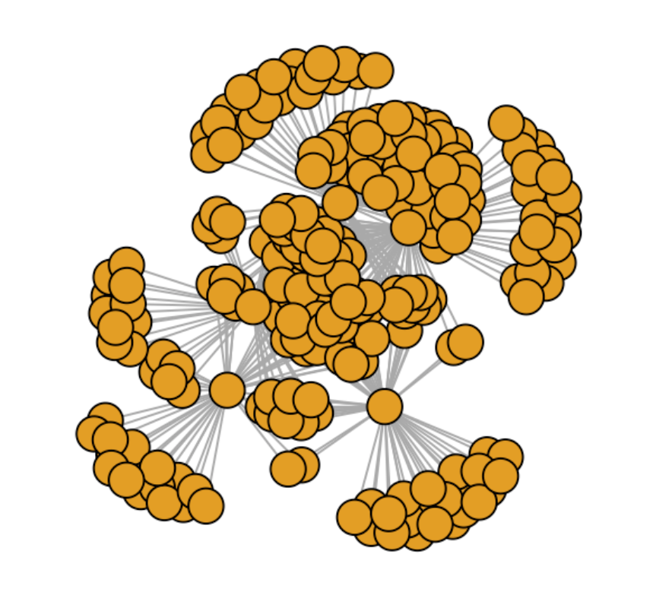
Citations of the 5 Most-Cited Articles
Articles that cite one of the most-influential articles also cite other top articles
Notes:
This graph shows a different perspective of the a conclusion we saw in the author graph: top authors cite one another.

Slide 60
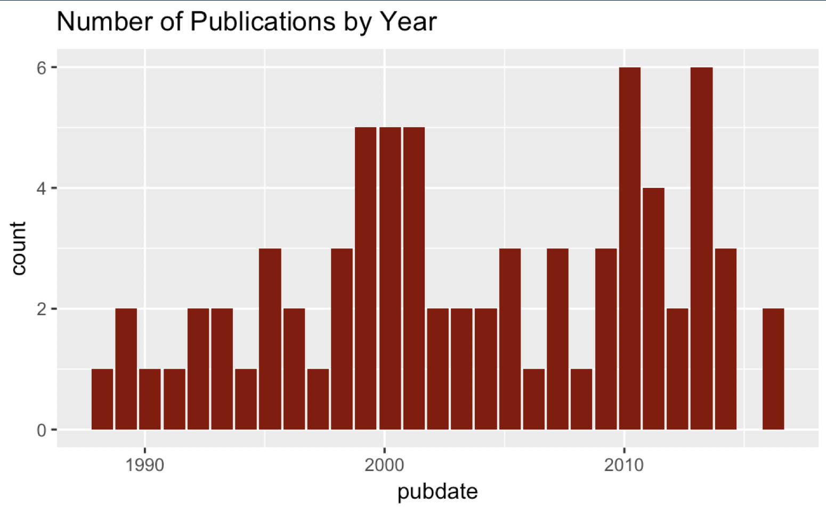
Most-cited research is also recent work
Despite seminal works being the most-cited work, the majority of research cited was published around 2000 with another peak in this decade

Slide 61
What are the main topics discussed in the research?

Slide 62
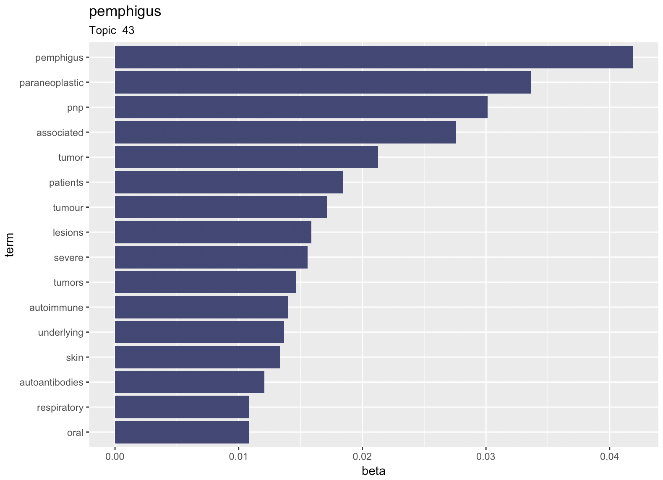
Topic Modeling
Top Topics: cell, case, detected, syndrome, rights, diagnosis, disorder, cases, review, treatment, localized, patients, cells, patients, cells, lymphoid, imaging, syndrome, disease, mcd, disease, patient, cells, tumor, mass, neck, multicentric, surgical, lymphoma, chest, node, renal, lymphadenopathy, lymph, features, vascular, treatment, may, associated, il6, disease, hhv8, pemphigus, kshv, serum
Through Latent Dirichlet Allocation, a form of unsupervised learning, we can discover the topics being discussed in a corpus of works
We can also drill into a specific topic and see the main terms contributing to this topic

Slide 63
Sum it up for me
Pathogenic significance of interleukin-6 (IL-6/BSF-2) in Castleman's disease. In a patient with a solitary hyperplastic lymph node, clinical improvement and decrease in serum IL-6 were observed following surgical removal of the involved lymph node. The findings in this report indicate that the generation of IL-6 by B cells in germinal centers of hyperplastic lymph nodes of Castleman’s disease may be the key element responsible for the variety of clinical symptoms in this disease.
Kaposi's sarcoma-associated herpesvirus-like DNA sequences in multicentric Castleman's disease. In this study, we searched for these Herpesvirus-like sequences in MCD samples of 31 patients. KSHV sequences were detected in 14 of 14 cases of HIV-associated MCD, including 5 cases without detectable KS.
Humanized anti-interleukin-6 receptor antibody treatment of multicentric Castleman disease. Within 16 weeks, treatment with MRA consistently alleviated lymphadenopathy and all the inflammatory parameters. In 8 (28.6%) patients, the MRA dose was decreased or the treatment interval was extended without exacerbation.
Through a process of document summarization, we can also extract the most relevant sentences from that document in order to auto-generate a summary
The summaries to the right are for 3 of the top-cited articles
Notes:
Bold text is the article title. Plain text is the auto-generated summary.

Slide 64
Hierarchical Clustering
Clusters and their top terms
1 disease, castleman, castleman_disease, mass, type
2 6, mcd, treatment, il_6, siltuximab
3 fdg, pet, ct, fdg_pet, pet_ct
4 kshv, kaposi, kaposi_sarcoma, sarcoma, ks
5 poems, syndrome, poems_syndrome, polyneuropathy, skin
6 tafro, syndrome, tafro_syndrome, thrombocytopenia, anasarca
7 mcd, hiv, hhv8, patients, rituximab
8 renal, vegf, amyloidosis, nephrotic, biopsy
9 pemphigus, pnp, paraneoplastic, paraneoplastic_pemphigus,
patients
10 8, hhv, hhv_8, mcd, hiv
11 il, 6, il_6, tocilizumab, interleukin
12 cells, cases, cell, follicular, dendritic
13 syndrome, therapy, criteria, cell, poems_syndrome
14 igg4, related, igg4_related, serum, serum_igg4
15 6, vil_6, vil, 8, il_6
Hierarchical clustering presents another method to organize and group similar documents
Using 15 clusters, 40% of documents fall into one cluster
This indicates that we may need to change the number of clusters

Slide 65
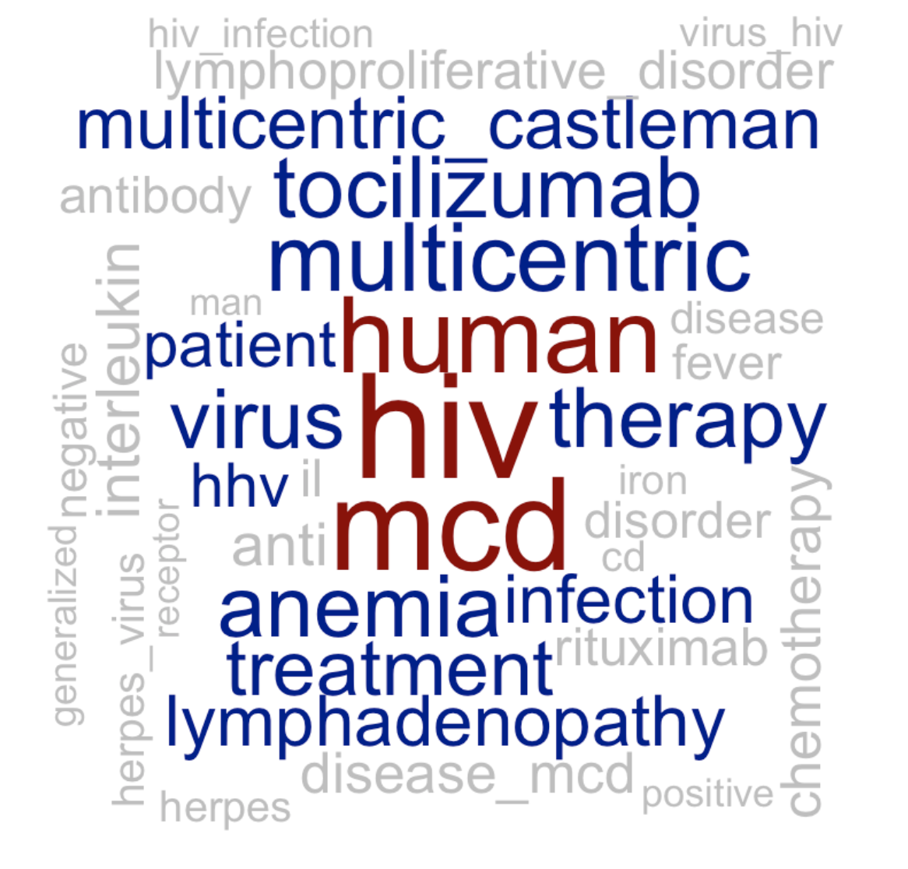
Terms in a cluster
Similar to LDA topic modeling, we can drill into each cluster and see the most frequent terms
The terms for one cluster are shown to the right in a Word Cloud, where a word is sized proportional to its frequency in the cluster

Slide 66
Finding the Optimal K
One problem when doing any kind of unsupervised learning in order to cluster or group data is determining the number of groups (k). While each algorithm tries to calculate the best cluster for each entity, the analyst must set the value of k at the outset.
Since each algorithm calculates different clusters differently, we need different methods for calculating k.
Notes:
Source: Anand, 2017

Slide 67
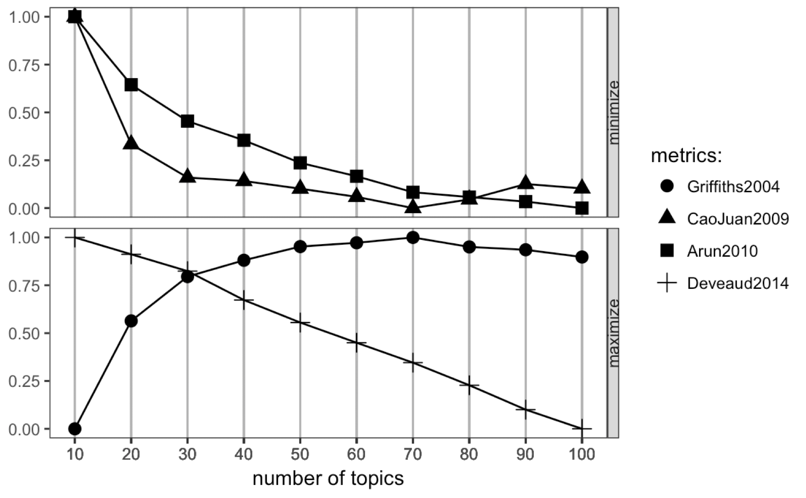
Determining k for LDA
The aim of these measurements is to minimize the top two metrics (Arun, CaoJuan) and maximize the bottom two metrics (Griffiths, Deveaud). The optimal number of topics is found where the four lines converge, somewhere between 40-50 topics.
Notes:
This method was used to determine the optimal number of topic for the first unsupervised learning approach presented in this document.

Slide 68
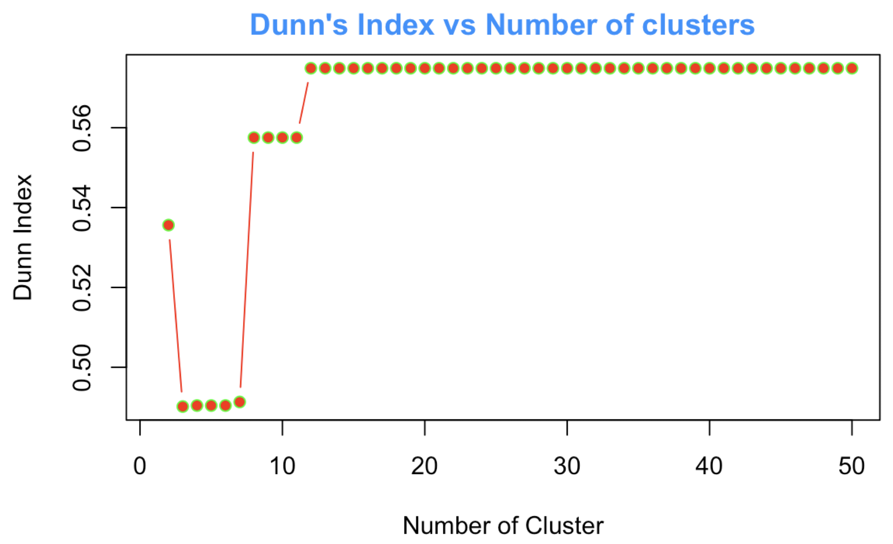
Dunn’s Index
Dunn’s Index attempts to measure clusters by how tight and distinct they are. The index is a measure of the intranodal distances for points within a cluster and the internodal distance between clusters. k values with high index values have low intranodal distance and high internodal distance
Notes:
Dunn’s index was used to evaluate different k values for hierarchical clustering, the second topic analysis approach presented earlier.

Slide 69
Findings + Recommendations

Slide 70
Review of Hypotheses

Slide 71
Hypotheses in support of Problem Statement 1
Hypothesis 1
H₁ = Text mining of scientific literature for insights and information is more effective and efficient than manual reading of the corpus.
Partially-Supported. This analysis has shown in the time it takes to run the R script (~1 hour), we can extract extensive insights from 2500 articles, from publication trends to text summarization. The question of efficiency remains outstanding and would need a medical SME to evaluate.
Hypothesis 2
H₁ = A set of related scientific articles has discoverable patterns of topics that can be used to organize the documents into meaningful clusters.
Supported. Multiple analytical methods and models discovered relevant topics in the corpus of article abstracts.
Notes:
Problem Statement 1 Conclusion
By creating a shared and standard approach for extracting insights from the medical literature, pharmaceutical researchers can remove a resource and time burden and focus on the areas where they can build competitive advantage.

Slide 72
Hypotheses in support of Problem Statement 2
Hypothesis 1
H₁ = Text mining can be used to extract relevant market trends from a corpus of scientific literature automatically.
Partially-Supported. Trend analysis was useful for identifying publication trends and the most-cited articles. However, entity ambiguity and missing data make resolute findings for research connections, Open Access, and funder trends difficult.
Hypothesis 2
H₁ = The most influential and cited papers can be automatically identified by a computer.
Supported. The computer, through the generation of a citation graph, could readily isolate the most-cited papers.
Notes:
Problem Statement 2 Conclusion
By creating and providing objective descriptions of the current state of the OA market landscape, we can provide consistency and clarity to the understanding of the market from which scientific publishers can ground their go-forward decision making.

Slide 73
Hypotheses in support of Problem Statement 3
Hypothesis 1
H₁ = NLP tools can be used to automatically generate an accurate summary of an article.
Partially-Supported. This project demonstrated that NLP methods can be used to generate summaries of text documents based on the statistical relevance of sentences in that document. The question of the quality of these summaries remains outstanding and would need a medical SME to evaluate.
Hypothesis 2
H₁ = The corpus of scientific literature contains retrievable facts that can be discovered automatically.
Supported. This analysis has shown in the time it takes to run the R script (~1 hour), we can extract extensive insights from 2500 articles, from publication trends to text summarization.
Notes:
Problem Statement 3 Conclusion
By finding a mechanism by which we can automatically catalog, classify, and curate artifacts from the grey literature corpus, we can surface important and valuable artifacts of information to researchers interested in understanding emerging trends and new discoveries in their field.

Slide 74
Recommendations

Slide 75
Research Paths
Beyond the confirmation / negation of any of the specific hypotheses, this research project had as its goal the development of a proof-of-concept for exploring and extracting information from a corpus of text (‘Literature-based discovery’).
To this end, I have demonstrated that there are numerous different approaches that can be applied to published article metadata that reveals information of value.

Slide 76
Research Path 1
For researchers new to a specific topic, the set of methods demonstrated in this POC can be used to answer questions such as:
When did the research on this topic happen?
Who is publishing in this area?
Which institutes are involved in this research?
What are the main topics covered in the literature?
What are the seminal articles that I should read?
What are those articles about?

Slide 77
Research Path 2
For researchers familiar with a specific topic, the set of methods demonstrated in this POC can be used to answer questions such as:
Who is publishing with whom? Who is working independently and what should I know about their work?
Which institutions are collaborating on research?
Who is funding the research in this topic?
Which articles cover the topics of my interest?
What influential articles fall outside the core corpus?

Slide 78
Future Research

Slide 79
Future research
This project leaves many questions unanswered, creating opportunities for additional research.
How can these methods be scaled beyond a small set of articles (i.e. the full, 29 million article set from MEDLINE)?
Can we train a model to predict the MeSH heading for an unlabeled article?
How can we better resolve entities such as authors and institutions?
Which topics are receiving the most funding?
Will this analysis work in other disciplines?
Notes:
For example, there are other citation databases publicly available, such as dblp for computer science philpapers.org for philosophy papers.

Slide 80
Summary

Slide 81
1-Page Take Home
Guiding question: How can a researcher quickly identify information pertinent to their area of study?
Main conclusion: Literature-based discovery and NLP is an efficient and effective method for extracting information and insights from large sets of data that benefit the scientific researcher.
Analysis requirements: Analysis was conducted on publicly available data with open source tools.
Next steps: opportunities exist for applying predictive analytics to text as well as analysis at scale.

Slide 82
References

Slide 83
References
American Cancer Society. (2018, February 1). What is Castleman disease? Retrieved from https://www.cancer.org/cancer/castleman-disease/about/what-is-castleman-disease.html
Anand, S. (2017, February 9). Finding optimal number of clusters. Retrieved from https://www.r-bloggers.com/finding-optimal-number-of-clusters/
Bradford, L. (2018, September 6). 8 real challenges data scientists face. Retrieved from https://www.forbes.com/sites/laurencebradford/2018/09/06/8-real-challenges-data-scientists-face/#4cce51d66d99
brennonborbon. (2017, December 16). *Creating simple world maps in ggplot2 for beginners.* Retrieved from https://brennonborbon.wordpress.com/2017/12/16/creating-simple-world-maps-in-ggplot2/
Buranyi, S. (2017, June 27). Is the staggeringly profitable business of scientific publishing bad for science? Retrieved from https://www.theguardian.com/science/2017/jun/27/profitable-business-scientific-publishing-bad-for-science

Slide 84
References (cont.)
Cairns, M. (2018, January). Market survey of ERP and CMS software solutions for publishing companies - 2018 [Report]
Campfens, Y. (2019, January 15). Market research report: what has become of new entrants in research workflows and scholarly communication? [Whitepaper]. Retrieved from https://osf.io/a78zj/
Ćirković, S. (2018, June). Grey literature--the chameleon of information resources. Infotheca, 18(1), 75-83. DOI 10.18485/infotheca.2018.18.1.5
Gyrgorian, A. (2017, April 24). Text mining. Clustering analysis. Retrieved from https://rstudio-pubs-static.s3.amazonaws.com/271085_3772c982c5664206aab04b842a04a761.html
Henry, S., & McInnes, B. (2017). Literature based discovery: models, methods, and trends. Journal of Biomedical Informatics, 74 (20-32). doi: 10.1016/j.jbi.2017.08.011
Jones, T. (2019, March 21). 5. Document summarization. Retrieved from https://cran.r-project.org/web/packages/textmineR/vignettes/e_doc_summarization.html

Slide 85
References (cont.)
Jones, T. (2019, March 21). 6. Document clustering. Retrieved from https://cran.r-project.org/web/packages/textmineR/vignettes/b_document_clustering.html
Jones, T. (2019, March 21). 3. Topic modeling. Retrieved from https://cran.r-project.org/web/packages/textmineR/vignettes/c_topic_modeling.html
Makar, A. (2018). Develop a project scope statement with MindGenius. Retreived from https://www.mindgenius.com/how-to-guides/project-scope-statement.aspx
National Center for Science and Engineering Statistics. (2017, October). Science and engineering publication output trends. Retrieved from https://www.nsf.gov/statistics/2018/nsf18300/nsf18300.pdf
The New York Academy of Medicine. (n.d.). What is grey literature? Retrieved from http://www.greylit.org/about
Open Society Foundations. (2018, September). What is ‘Open Access’? Retrieved from https://www.opensocietyfoundations.org/explainers/what-open-access ORCID. (n.d.). What is ORCID. Retrieved from https://orcid.org/about

Slide 86
References (cont.)
Piowar, H., et al. (2018, February 13). The state of OA: a large-scale analysis of the prevalence and impact of Open Access articles. PeerJ, 6:e4375; DOI 10.7717/peerj.4375
Pistoia Alliance. (2018, October 9). Pistoia Alliance Centre of Excellence for AI/ML in Life Sciences Workshop & Datathon Launch. Workshop held in Boston, MA.
Tollefson, J. (2018, January 18). China declared world’s largest producer of scientific articles. Retrieved from https://www.nature.com/articles/d41586-018-00927-4
U.S. National Library of Medicine. (n.d.). Pubmed [Website]. Retrieved from https://www.ncbi.nlm.nih.gov/pubmed/
U.S. National Library of Medicine. (2016, 29 September). National library of medicine terms and conditions. Retrieved from https://www.nlm.nih.gov/databases/download/terms_and_conditions.html
U.S. National Library of Medicine. (2018, December 27). MEDLINE: description of the database. Retrieved from https://www.nlm.nih.gov/bsd/medline.html

Slide 87
References (cont.)
U.S. National Library of Medicine. (2018, December 20). Welcome to medical subject headings! Retrieved from https://www.nlm.nih.gov/mesh/meshhome.html

